Slide 1
2022 County Election Administration Training
Election Judge Training

Slide 2
Training Agenda
Preparing for Election Day
Opening Duties
Election Day Stations & Tasks:
Greeter Station
Roster Station
Registration Station
Demonstration Station
Ballot Station
Ballot Counter Station
Polling Place Conduct
Security Practices
Closing

Slide 3
Preparing for Election Day

Slide 4
Time Off From Work
Notify employer in writing 20 days in advance
Provide appointment letter
Employer can reduce wages by amount paid
Notes:
You have the right to take time off from work to serve as an election judge. In order to do so, you should notify your employer at least 20 days before Election Day, and if you would have earned more working at your day job than as an election judge, your employer will pay the difference. For example, if you are making $10/hr as an election judge, and at work you would make $15/hr, your employer will still pay you the difference of 5 dollars an hour for hours you would have worked. Your election office will provide you with the appropriate notification letter for your employer, on the office letterhead.

Slide 5
Election Day Logistics
Dress comfortably
Do not wear anything political
Have a food plan
Plan (care of pets or loved ones, ride home, etc.)
And most importantly… don’t forget to vote!
Notes:
Election Day is a long day, so please be mindful about taking care of yourself. Have a food plan, is your polling place around restaurants open for lunch? Do you need to bring your own breakfast, lunch and dinner? Are you located in a breezy gymnasium and should wear layers?
There is no formal dress code for election judges. We only ask that you wear nothing political, as polling places are a politically neutral space.
You may work in a precinct outside of your own, which means you may have to vote absentee, before Election Day. If you do work in the polling place for the precinct in which you live, please vote on Election Day! We just ask that you move to the other side of the check in table and go through the voting process like any other voter.

Slide 6
Opening Duties

Slide 7
Code of Conduct
All election judges take and sign this oath:
“I solemnly swear (or affirm) that I will perform the duties of election judge according to law and the best of my ability and will diligently endeavor to prevent fraud, deceit and abuse in conducting this election. I will perform my duties in a fair and impartial manner and not attempt to create an advantage for my party or my candidate.”
M.S. 204B.24
Notes:
At the beginning of your shift, you will affirm the election judge oath, administered by your head election judge.

Slide 8
Code of Conduct
What does this oath look like in practice?
Be impartial, courteous and professional
Maintain your polling place’s accessibility, neutrality, and efficiency
Enjoy assisting and serving diverse populations
Notes:
Keep in the mind that voters remember their Election Day voting experiences. Voting isn’t just another monotonous interaction with the government, voting can be very high-stakes and exciting. Voters remember their check-in process, how long they waited in line, if they had more obstacles or perceived obstacles to voting than the person in line before them, etc. And they really like receiving an I Voted sticker. We want to make every voter’s Election Day experience is a smooth and efficient one, just as we would want that for ourselves. There is more information regarding professional expectations of election judges found in the election judge guide.

Slide 9
Discussion Question
Have you ever had a difficult voting experience? What made it difficult?

Slide 10
Overview of Polling Place Judges
Head/Assistant Judge
Greeter Judge
Roster Judge
Registration Judge
Demonstration Judge
Ballot Judge
Ballot Counter Judge
Student Judge
Notes:
Every polling place has a head judge and, sometimes, an assistant head judge, who are seasoned judges with additional training. Their number one job, is to support their team. Your head and assistant head judges are a resource for you to use throughout Election Day.
The greeter judge stands near the entrance, to welcome voters and manage the lines. The greeter judge also has the tools necessary to check to see if a voter is in the correct precinct, or to see if they are pre-registered.
The roster judge checks in pre-registered voters, and the registration judge helps voters to register on Election Day
The demonstration judge gives an overview of the ballot and how to properly mark it, the ballot judge tracks voter receipts and hands out ballots
The ballot counter judge helps voters when the error screen on the ballot tabulator pops up, and hands out ‘I Voted’ stickers!
There are also student judges, these are 16 – 17-year-old high school students who can do all the same activities as other judges, except for party balance activities. Because they are not yet 18, they can’t yet formerly affiliate with a political party.

Slide 11
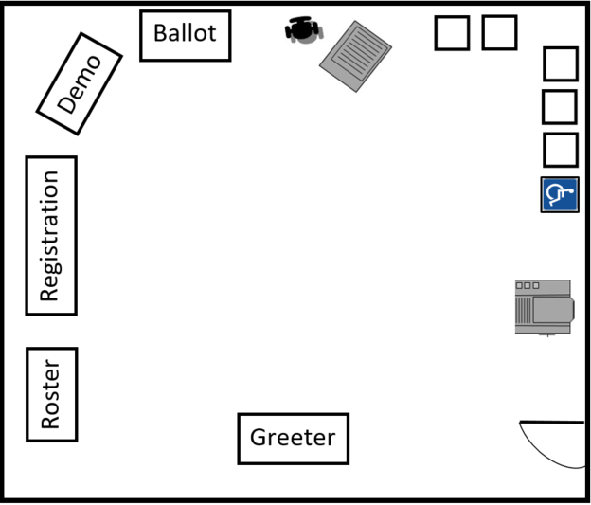
Polling Place Layout
Notes:
Here is a typical polling place layout,
On Election Day, keep in mind:
Location of power sources/outlets
Accessibility – where are our directional signs placed? Where are our accessibility signs placed?
This may look different with poll books – where can you safely set up your modem?
Consider having an overflow voting table
Are there chairs available for voters waiting in line?

Slide 12
General Guidelines
Access
Are all parts of the polling place accessible for voters? Can a voter using a wheelchair easily move from station to station?
Traffic Flow
Where will lines likely bottleneck? Is it clear which station a voter should move to next?
Privacy
Arrange the voting stations with privacy in mind, including the assistive voting device.
Notes:
Each polling place is different, here are some questions to ask yourself during set up in the morning to make sure that your polling place is as accessible as it can be.
Identify additional stable, flat surfaces (built in counter tops, additional tables, etc.) for voters to use if all voting booths are in use. Voters are not required to use a voting booth to vote. They can be given the option of other stable, flat surfaces within the polling place. It is the voter’s choice if they wish to wait for a voting booth.

Slide 13
Don’t forget…
A stable, flat surface for completing forms.
Chairs for voters waiting in line
Set up at least one voting booth that is wheelchair accessible and includes a chair

Slide 14
Additional Set Up Tasks
Designate and clearly mark disability parking spaces
Mark route to accessible entrance
Mark accessible route to voting room
Post informational posters
Post flag at entrance
Notes:
There are many signs that need to be posted in the polling place, both informative and directional. During morning set up, the head judge will assign at least one judge to put up their signs and posters in the polling place room, the building, and outside. Treat all signs as if they are required to be posted, because most of them are.
Head judges, please give your polling place a walk through before open to make sure that accessible parking spaces, routes, and directional signs are properly posted.

Slide 15
Equipment Set Up
Assistive Ballot Marking Device
The station must be private and wheelchair accessible, with headphones
Test when setting up:
Audio must be working
It must read a blank ballot correctly
Make sure touchscreen and buttons function
Notes:
An assistive voting device or ballot marking machine, allows for a voter to mark their ballot with either the touch screen (which can also be turned off for privacy) or buttons, which have braille on them. Through headphones, the machine can also read the ballot to the voter and tell them which choices they are marking as they vote.
We want to afford voters using the assistive ballot making device the same access and right to privacy as a voters completing their ballots in voting booths. When setting up the ballot marking device, keep in mind that it needs to be accessible for a voter using a wheelchair, but also the screen which shows the ballot’s contests and the voter’s choices must be turned away from the main flow of traffic through the polling place.
Provides privacy and independence to voters who cannot, or choose not, to vote using a pen
Displays the ballot in large print or with a high-contrast background
Can read the ballot to the voter through headphones
Allows voter to select candidates with a keypad, touchscreen (if applicable), or sip-and-puff device
Try using it to mark your own ballot to familiarize yourself with the system

Slide 16
Equipment Set Up
Ballot Counter
The head or assistant head judge will lead ballot counter set up
Verify ballot box is empty, and that zero votes have been counted on the machine
Lock or seal ballot box, record seal number
Notes:
The ballot counter counts and secures voter’s ballots. It will let the voter and ballot tabulator judge know if a vote was counted without issue, or if there was an error in reading the ballot. A typical error message may read that the voter voted for too many candidates in one contest, that the ballot is blank, or that they cross-party voted in a partisan primary election.
The ballot counter is set up by the head and assistant head judge. They verify that the machine has zero votes on it, and that is prepared to count the ballots accurately by checking the ‘zero tape’ against a ballot to see that the offices and candidates are displayed in the same order.
If ballot counter is not functioning properly, use auxiliary slot on ballot box and contact official

Slide 17
Prepare Ballots
Verify the total number of packets of shrink-wrapped ballots matches what is on the Ballot Tracking (or similar) Form
Open an initial supply of ballots, count them to verify how many there are
Two judges initial each ballot
Notes:
Your HEJ will advise you on how many packets of ballots to open in the morning. The Ballot Tracking Form (or something similar) is used to record how many ballots are prepared at the end of the day, to verify that you received the correct number of ballots in the morning, and to record how many blank ballots you have left at the end of the day.
But why wouldn’t you want to just open all the packets and get ballot preparation out of the way?
Because at the end of the night you need to provide the total number of blank ballots in your precinct. So, if you leave ballots in their shrink-wrapped packs until you need them, you can count how many packets you have left instead of how many individual blank ballots are in your precinct.

Slide 18
Incident Log and Party Balance
Incident Log
Document where any unusual events or problems are recorded
Party Balance
To ensure fairness, two judges of differing major political parties must do certain tasks together
Notes:
Before diving into the duties and processes that take place at each station, I want you to be aware of two things which come in to play often: the Incident Log, and party balance activities. We will be referring to both throughout the training, so allow me to clarify what they are now:
The Incident Log:
Typically maintained by head judges, the Incident Log lets official know what occurred in the precinct
Record how problems were resolved
Returned to clerk with precinct supplies
Party Balance:
The head judge is provided with the party affiliation of the judges on their team, and will assign judges to work with either their self or others to complete party balance activities, such as:
Assisting a voter with marking their ballot, or explaining a ballot marking error
Curbside voting
Opening the auxiliary compartment or the ballot box on the ballot tabulator during voting hours
Duplicating ballots

Slide 19
Election Day Stations & Tasks
Notes:
Throughout the day, you will work with your head judge to rotate between stations and duties.

Slide 20
Greeter Station

Slide 21
Greeter Judge
Welcomes voters
Line management
Able to check if voters are pre-registered or in the correct precinct.
Notes:
The greeter judge can make or break a voter’s experience, you are the first person voter’s interact with, so this is the station where we want our judges who are the best with people.
Be prepared to welcome voters, answer questions, and verify that voters are in the right place, whether they are registered, and if they have what they need to register on election day.
You will be provided with the Greeter’s List, which is a list of pre-registered voters in that precinct, which you can use to direct voters to either the roster station, or the registration table.
There is also a precinct finder, which has a list of street addresses in your municipality and which polling places residents of those address ranges vote at.

Slide 22
Roster Station

Slide 23
Roster Station
Ask voter for name and address
Check page for roster notations
Hide challenges on other voter records from view
Have the voter sign to affirm the voter’s oath
Give them a voter receipt and direct to Ballot Judge station
Notes:
The roster station is where we check in pre-registered voters. You will know a voter is pre-registered because their current name and address, which is information that they verbally provide you with, matches what you see in the roster.
A voter may hand you an ID to assist with locating their name—this is voter’s choice and not required. Clarify verbally an ID not necessary so that those nearby are not confused.
A roster notation is an additional mark on the roster,
If you get questions about the oath, there is a large print sign that is easier to read.
What if a voter is not on the roster? They need to go to the registration table.

Slide 24
Can’t find a voter’s name?
If the voter insists that they are registered:
Does voter’s name, address or date of birth on the roster contain a clerical error?
Roster correction form
Is voter at the wrong precinct?
If none of the above, they need to register at the registration table
Notes:
If a voter is insisting that they are pre-registered, but you are having a hard time pulling them up, work with the voter to find out the most likely scenario here. Do they have more than one last name, and may be listed under a different letter of the alphabet? Do they have a hyphenated name? Working with other government entities, do they often run into issues with their address or other information?
If you are looking for the name Peter St. James in the roster, you may need to look under the ‘Sa’s for the word ‘Saint’ and the ‘St’s for the abbreviation of ‘Saint’ or under ‘J’, for James. Please be patient and check all possibilities before sending the voter to the registration table, we don’t want them to jump through additional hoops to vote just because their name wasn’t there upon first glance.
Was their name was left off due to clerical error?
See Emergency Voting Procedures as per M.R. 8200.3800

Slide 25
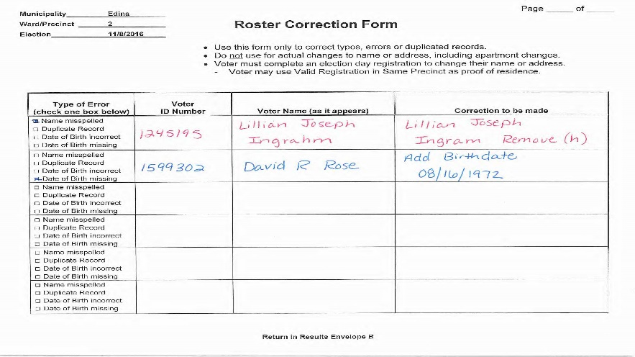
Roster Correction Form
Use the Incident Log or Roster Correction Form to notify the election office of any clerical errors
Notes:
If there is a clerical error in the voter’s record, such as their name is misspelled or there is a typo in their birthdate, the voter does not need to re-register or further prove that they are who they say they are in order to vote. Just because we goofed and made a typo, doesn’t mean there should be any additional obstacles between that voter and their ballot. Note the correct info on the incident log or on a roster correction form, and if there is more backstory that you think would be helpful, include any details that are important.
Other tips:
Maintain the roster carefully, it is a legal document that indicates a voter received and cast a ballot
Keep the roster free of unnecessary handwriting
Avoid using an “x” to identify where a person should provide their signature

Slide 26
Roster Notations
Notes:
Sometimes, when you page through the roster to find a voter’s record, there is an additional notation in the ‘Voter Signature’ line, indicating that there is a challenge on the voter’s record. Can anyone tell me one Michael Smith’s challenge record is?
Right, he was sent a piece of official election mail, and for one reason or another, it was sent back to the election office and marked as undeliverable by the postal service. Is Michael a bad guy? Is Michael looking to commit voter fraud? No, of course not. If anything, Michael is going to be confused.
There are many reasons a voter would have a challenge on their record, and each one is more bureaucratic than the next. If you see a challenge notation on a voter’s record, do not gasp or make a scene, simply tell the voter “There is a notation on your voter registration, the head election judge will help us check you in shortly.”
Just for your information, the head judge will put the voter under oath, ask them a pre-determined question or two, and based on the voter’s answer, they will either check them in or help them to further troubleshoot their registration.

Slide 27
Registration Station
Notes:
Voters who are not pre-registered must register on Election Day.

Slide 28
Election Day Registration
To register and vote on Election Day you must:
Be eligible to vote
Register and vote within your precinct
Provide proof of residence
Notes:
Minnesota consistently has some of the highest voter turnout in the country. A large part of this is because we have Election Day registration!
Voters who want to register on Election Day must provide proof of residence, in order to prove that they are eligible to vote in this precinct. There are several ways to provide proof of residence, some of which involve a voter showing us their photo ID, but many of them do not, and we will go over some of those examples shortly.
Can someone tell me some of the eligibility requirements?
-18, citizen, lived in MN 20 days, if once a felon, completed all parts of a felony

Slide 29
Eligibility
What are the voter eligibility requirements?
U.S. citizen
At least 18 years old on Election Day
Resident of Minnesota (NOT a specific precinct) for 20 days
Finished with all parts of any felony sentence
Notes:
A person can vote while under guardianship unless a judge specifically has revoked their right to vote.
A person cannot vote if a court has ruled that they are legally incompetent

Slide 30
Proof of Residence
There are 7 possible ways for a voter to provide proof of residence. Some of those ways involve a voter showing us an ID, others do not.
Please note:
We always ask voters for “proof of residence” not: “Can I see your ID”.
Notes:
We will go over each form of proof of residence in detail. Some are more common than others, and we can’t expect you to remember how to process each form of proof of residence in detail. You will always have your election judge guide, your head judge, and the elections office to refer to and ask questions!
Voter ID requirements are a hot button political issue, and in Minnesota, registered voters do not need to show an ID to check in and vote. Voters who need to register may end up showing us an ID as a form of proof of residence, but many will not have to do so. We always ask to see ‘proof of residence’ instead of ‘ID’, not only because asking for ID would be a break from procedure, but also because asking for ID has different connotations for every voter.

Slide 31
Option 1: ID With Current Name And Address
Current Minnesota driver’s license, learner’s permit or ID card – or a receipt for any of these
Tribal ID with name, current address, signature and picture.
Notes:
What does ‘Current’ mean? The ID is not expired, it has their current name, and their current address which is within the precinct.
If showing a receipt for an ID, you a NOT required to show an additional photo ID, the receipt alone is sufficient. Receipts may be on white or yellow paper.
A voter showing a Tribal ID is not required to live on a reservation for it to serve as a valid proof of residence.

Slide 32
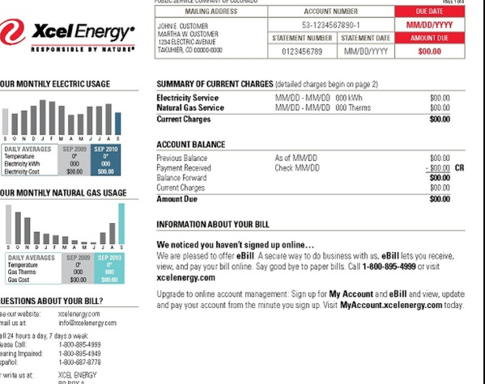
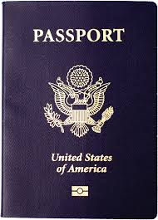
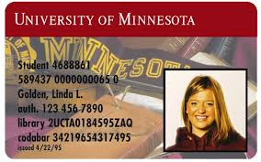
Option 2: Photo ID and a Document with Current Name and Address
Notes:
A voter could also show you a photo ID and a document with their current name and address. The ID could be one of the following options:
Driver's license, state ID or learner’s permit issued by any state
U.S. Passport
U.S. Military or Veteran ID
Tribal ID with name, signature and photo
Minnesota university, college or technical college ID
Minnesota high school ID
The document must be one of the following:
Bill, account or start-of-service statement for: Phone, TV or internet
Solid waste, sewer, electric, gas or water
Banking or credit card
Rent or mortgage
Residential lease or rent agreement valid through Election Day
Current student fee statement

Slide 33
Option 2: ID and a Document with Current Name and Address
Can this bill or document be dated at just any date?
No. It must be due or dated within 30 days of Election Day.
Can a voter show you this document on their phone?
Yes!
Can the ID be expired, or have an old address listed?
Yes!
Notes:
A voter could also show you a photo ID and a document with their current name and address. The ID could be one of the following options:
Driver's license, state ID or learner’s permit issued by any state
U.S. Passport
U.S. Military or Veteran ID
Tribal ID with name, signature and photo
Minnesota university, college or technical college ID
Minnesota high school ID
The document must be one of the following:
Bill, account or start-of-service statement for: Phone, TV or internet
Solid waste, sewer, electric, gas or water
Banking or credit card
Rent or mortgage
Residential lease or rent agreement valid through Election Day
Current student fee statement
Q: Can this bill or document be dated at just any date?
A: No, it has to be due or dated within 30 days of the election. That’s how we know it is their current information!
Q: Can a voter show you this document or bill on their smart phone?
A: Right, a voter can absolutely show you this document on their phone.
Q: Can the ID be expired, or have an old address or name listed?
A: Yes.

Slide 34
“Temporary” or “Status Check” Notification on IDs
If there is a notation of “temporary” or “status check” on the ID…
it could mean that the person holds a visa and is not a US citizen
Talk with the person, in a respectful manner, about the notification.
Do not assume that this, “for sure” means that the person is not a citizen…
The person might have obtained citizenship since the issuance of the ID?
Notes:
If there is a notation about “temporary” or “status check” on the ID, have a respectful discussion with the person. It doesn’t necessarily mean that the person is “for sure” not a citizen. It could be a situation where they have obtained citizenship since issuance of the ID? In many cases, the person might only be in the US on a type of work or student visa. In this case, explain to the person, in a respectful manner, that they are not eligible to vote and will not receive a ballot. This person will not be able to vote and so documenting the “turn away” (must keep track of that number) and making a notation in the incident log is required.
If questions are asked of the person, make sure they focus upon the notation on the ID and are helpful in nature. Making sure to explain the requirement to be a US citizen to vote and not making the person feel unwelcomed, harrassed or discriminated against.

Slide 35
Option 3: Vouching
If you don’t have a document to serve as proof of residence… you can bring a person!
A voucher must know the voter personally
Vouchers must live in the same precinct, and either be preregistered to vote or register on Election Day.
A person who is vouched for on Election Day cannot then vouch for someone else
Notes:
The voter and voucher will complete the form on the backside of the voter registration application.
Q:Does anyone remember how many voters a voucher can vouch for?
A: Right, they can vouch for 8 voters. We track this on the Precinct List of Persons Vouching Form.

Slide 36
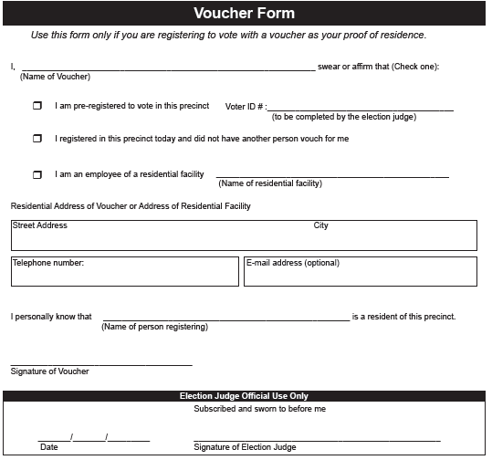
Voucher Form
Notes:
Q: Where can we find a pre-registered voucher’s voter ID number?
A: In the roster
Q: Where do we find the voter ID number for a voucher who is registering on Election Day?
A: Right, they don’t have a voter ID number, and so the form does not have a space for it to be entered. Don’t over think it!

Slide 37
Option 4: Residential Facility Vouching
If a voter lives in a residential facility, a staff person of that facility can vouch for them.
The staff person must provide proof of employment, which could be either:
an employee badge
a letter of employment on the company letter head.
Notes:
If a voter lives in a residential facility such as a nursing home, homeless shelter, battered women's shelter, or assisted living, a staff person can vouch for them.
Q: How many voters can this residential facility voucher vouch for?
A: As many as live in that facility and come in to vote
Q: Does the residential facility voucher need to be eligible to vote in that precinct?
A: No, they do not.

Slide 38
Option 5: Notice of Late Registration
Notes:
There is a pre-registration cut off date 20 days before the election. This cut off date gives county election offices time to update and upload voter files that we can then download onto electronic rosters or print.
If a voter registers within this 20-day window, the county election office will attempt to process their application and send them a notice of late registration postcard or letter. If a voter receives this in time, they can bring it in, and it will serve as their proof of residence. So, the voter will have to register again, but that document will serve as their necessary proof of residence.

Slide 39
Option 6: Valid Registration in the Same Precinct
If the voter was preregistered in the precinct, but:
Has changed their name
Has moved, but within the same precinct
Then the voter’s previous registration serves as their proof of residence
Notes:
Procedure: Find voter’s name on roster and copy their voter ID number in the ‘other’ section on the bottom of the registration application
This may seem confusing at first but think of it this way: if a voter has a pre-existing registration that same precinct, it means that their existing voter record has been recently been checked validated by election officials. If a voter has switched apartments, moved across the street, or changed their name for any reason, this is all information that can be verified by election officials just the same as any other proof of residence provided.

Slide 40
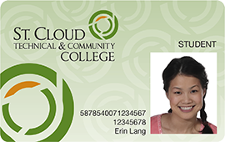
Option 7: Student ID with College List
Precinct may be provided with a list of students housed at a Minnesota college or university
Students on list can register by showing a current, valid student photo ID
Notes:
For precincts which have college housing in them, the college has the option of providing the polling place with a list of students who live in said housing. This list allows for college students to register in the polling place, by simply providing their student ID that we can use to match their name to one of the names on the list provided by the college.

Slide 41
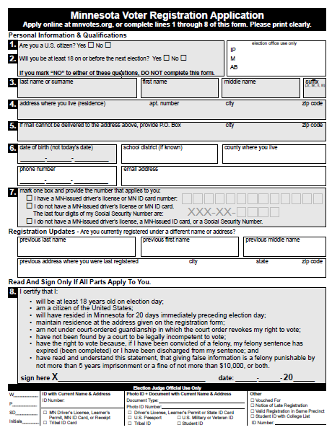
Voter Registration Application

Slide 42
Voucher Form

Slide 43
‘Official Use Only’ Section
Old forms can still be used—make edits as appropriate
New form:
Notes:
Remind to cross out “MN” for example, and list what state ID is from

Slide 44
Don’t Forget to…
Document proof of residence provided on bottom of voter registration application
Have voter complete and sign new registrant roster page
Give the voter a voter receipt and direct to demonstration or ballot judge

Slide 45
Demonstration Station
Notes:
The demonstration judge helps the voter to understand how to mark their ballots without making any ‘ballot marking’ mistakes. Examples of common ballot marking mistakes are:
Cross party votes in a partisan primary
Voting for too many candidates in a single race
Accidental marks outside of the ‘bubbles’ which could trip up the tabulator
Not completely filling in the bubbles

Slide 46
Ballot Marking Instructions
Create a speech that works for you! Here is what should be included:
Make all voters aware that they can use the assistive voting device, voting booths, or a table to mark their ballots
Made a mistake? Bring your ballot back and get a replacement!
Be sure to point out the ballot counter
Notes:
We always offer the assistive ballot marking machine to all voters, because we can’t assume who would benefit from using it and who wouldn’t.
Other things to include:
Fill in the oval next to the candidate or question on the ballot you wish to vote for
If there are two sides of the ballot, make the voter aware of that
If there are different kinds of races on the ballot, such as partisan races, ranked choice races, or ballot questions, you can make them aware of that as well.
When explaining to a voter how to properly mark their ballot, be sure that you are not pointing at only one candidate or political party on the sample ballot. It is best to gesture at the ballot with an open hand, as you explain partisan primary divides or other details.

Slide 47
Instructions for Partisan Primary Elections
No space for write-in votes
On partisan races, only vote for candidates from one political party. If you vote for candidates from both political parties, your votes will not count.
Do not interpret what a ballot question means or what impact there would be if it passed or failed
Instructions for Ballot Questions
Notes:
Voters will ask you questions about ballot questions, often seeking clarification on what they are asking and what the implications of those ballot questions are should they pass or fail.
Of course, as election judges, we can’t discuss what is on the ballot, and that includes ballot questions.

Slide 48
Ballot Station
Notes:
The ballot station is where voters receive their ballot.
Q: What do we need to receive from the voter before handing them a ballot?
A: Voter receipt!
We need to receive a voter receipt from each voter before handing them their ballot, because those receipts are how we keep an accurate count of how many ballots we are giving out. If there have been no hiccups, the number of voter receipts counted at the ballot station, should match the number of votes on the ballot counter.

Slide 49
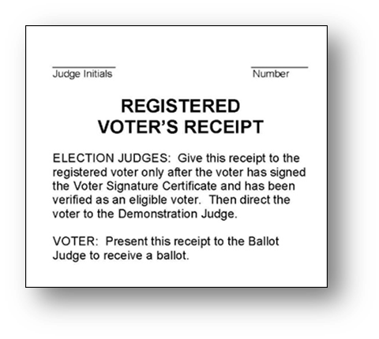
Ballot Judge
Counts and tracks packs of ballots
Collects voter receipts
Issues ballots
Notes:
Be sure to give correct ballot in split school district precincts.
An easy way to keep track of your voter receipts, is to number them as you receive them, and to bundle them in packs of 25 with either a paper clip or rubber band. That way, if your hourly audit numbers are off for some reason, it will be easier to count your receipts and to go through the most recent bundles to make sure they were counted properly.

Slide 50
Spoiled and Found Ballots
Spoiled ballot:
Exchange for new ballot and put into spoiled ballot envelope
Found ballot:
Mark “found in ___” on the ballot and put in spoiled ballot envelope
Record on incident log
Notes:
If a voter makes a ballot marking mistake, they can bring their ballot back to receive a new one. Their original ballot goes in the spoiled ballot envelope.
Voters sometimes leave the polling place without casting their ballot or confuse the assistive ballot marking device for the tabulator, and end up leaving their ballot in that device, in a voting booth, on the floor, wherever. Found ballots go in the spoiled ballot envelope,
Q:Is there any reason to change the voter receipt numbers if a voter requests a new ballot?
A: No! At the end of the night, we count how many spoiled ballots there are. So that voter still only votes one ballot, and only needs one voter receipt, and all of our numbers will still be on.
Q: What if you a find a ballot in the assistive ballot marking device that is filled out, clearly left by a voter who thought they were having their vote counted in the tabulator? Can this ballot go into the ballot counter under these circumstances?
A: No, that ballot cannot be counted. We can’t be sure of that ballot’s life story, so to ensure the integrity and security of our elections, it goes in the spoiled ballot envelope with the rest.

Slide 51
Ballot Counter Station
Notes:
At the ballot counter station, we ensure that voters ballots are being properly counted by the machine, and most importantly, provide ‘I Voted’ stickers. ☺

Slide 52
Ballot Counter Judge
Monitor operation of the ballot counter
Distribute “I Voted” stickers
Do not place the stickers on voters
Notes:
After alerting the head judge, two judges of different political parties open ballot box to take out ballots if full
If removing ballot from a tabulator with a separate compartment for write-ins, keep ballots with write-ins in separate container
Record time, initials of judges and any seal numbers used to secure ballots in Incident Log
Generally, only the voter should be within 6 feet of the tabulator. Line management may come into play for larger turnout elections.
If you suspect the tabulator is not functioning properly, alert your head judge.

Slide 53
Ballot Marking Errors
Machine will beep and return the ballot if there was a ballot marking error
Voter may choose to spoil their ballot and get a new one, or they can cast it as is.
Notes:
If the error screen pops up on the ballot counter, let the voter know that there was an error in marking their ballot. If you are going to discuss the error in general, such as simply explaining the logistics of a cross party vote, or what an ‘over vote’ is, that is totally fine. But if the voter is asking for you to examine their ballot and explain further, be sure to do this with a second judge who can provide party balance.
STATE PARTISAN PRIMARY ERRORS: Please know that if a voter cross party votes in a partisan primary, none of their votes in the partisan part of the ballot will be counted. Be sure to take the extra time to explain to voters the consequences of casting a ballot after such an error is made, because we want everyone’s vote to count!

Slide 54
Polling Place Conduct
Notes:
Let’s review guidelines for fairness and order in the polling place

Slide 55
Who is Allowed in the Polling Place?
Largely, only election judges, voters, and voter assistants should be in the polling place.
Other common authorized visitors are:
Challengers
The Media
Observers with written authorization
Notes:
A full list of authorized persons is in your election judge guide. If someone from the media has entered or wishes to enter the polling place, alert your head judge.
Observers can be authorized by the county auditor, clerk or OSS. They will have written authorization.

Slide 56
Appointed Challengers
Challenger must have personal knowledge that a voter is not eligible
Suspicion is not a basis for making a challenge
Challengers cannot:
Speak to voters and election judges
Inspect or handle any election materials
Make a list of who has voted
Be disruptive
Take photos
Go within 6 feet of the tabulator or influence voters
Notes:
While challengers are appointed by political parties for partisan offices, by candidates for nonpartisan offices, they can be an election judge or any eligible voter in the precinct could also contest a voter’s eligibility. It is important to note that challengers are not poll watchers, we do not have poll watchers in Minnesota.
If there is an appointed challenger in your precinct, your head judge will speak with them and get them seated in a space where they can observe the check-in tables.

Slide 57
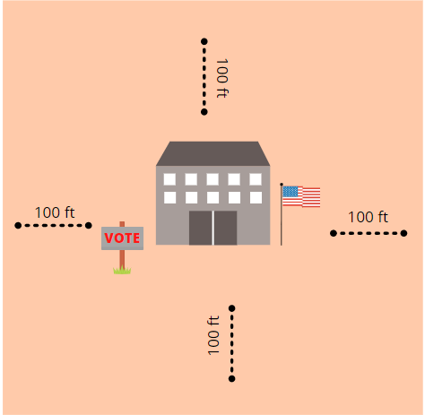
Prohibition on Campaigning
No campaigning or lingering within 100 feet of the polling place
Notes:
Within 100 feet of the polling place, there can be no campaigning or lingering
If polling place is on public property, campaigning not allowed anywhere on the property, even beyond 100 feet
Does not apply to adjacent private property

Slide 58
Prohibition on Campaigning
Voters may not wear or display campaign materials:
If it is on the ballot, it cannot be displayed in the polling place.
A voter may wear or display political material that is not on the ballot.
Election judges may not wear or discuss anything political
Notes:
Within 100 feet of the polling place, there can be no campaigning or lingering
If polling place is on public property, campaigning not allowed anywhere on the property, even beyond 100 feet
Does not apply to adjacent private property
Ask voters to either cover up or remove campaign material while in the polling place.
If they refuse, they can vote but record their name and note the event in the Incident Log

Slide 59
Security Practices
EJs are the 1st Line of Defense for physical & cyber security of Minnesota’s elections!
Watchful throughout election day:
All voting equipment
Removable memory devices
Ballots
Supplies
Anything suspicious & all incidents, communicated to the local election official immediately
Notes:
Security Practices
Election judges represent the first line of defense for the physical and cyber security of Minnesota’s elections. All election judges must keep a watchful eye on all voting equipment, removable memory devices, ballots & supplies throughout the Election Day. Individuals observed inspecting, assessing or attempting to access or connect a device to voting equipment input/output data ports should be addressed by the head judge (and additional election judges if needed), with the incident communicated to the local election official immediately.

Slide 60
Security Practices
Good practice to:
View & inspect seals on all port plugs on all equipment & ballot storage containers.
Take seriously voter reports of email, text, social media, phone or other communications attempting to disrupt or spread misinformation about the voting process.
If you observe any suspicious activity of anyone in the polling place, including other election judges, report your concerns immediately to the local election official
Report to the local election official, immediately, all items related to election security!
Notes:
Security Practices
Further, it is good practice to view/inspect the seals and any port plugs on voting equipment & ballot storage containers throughout the day, with concerns again being reported immediately.
Voter reports to election judges of observation of any of the above, or of e-mail, text, social media, phone or other communications attempting to disrupt or influence the elections process should similarly be reported.

Slide 61
Security Practices
Sergeant-at-arms or peace officer:
May be requested to arrest or remove from the polling place any individual who, despite a warning to desist, engages in disorderly conduct, to include tampering with voting equipment.
Notes:
Security Practices
A sergeant-at-arms or a peace officer may be requested to arrest or remove from the polling place any individual who, despite a warning to desist, engages in disorderly conduct, to include attempting to tamper with voting equipment.

Slide 62
Security Practices
Sergeant-at-arms or peace officer:
Shall not otherwise interfere in any manner with voters.
A peace officer cannot remain in or within 50 feet of the entrance of the polling place once peace has been restored.
Note the details of all security concerns & how they were addressed on the incident log
Notes:
Security Practices
A sergeant-at-arms or a peace officer shall not otherwise interfere in any manner with voters. The peace officer cannot remain in or within 50 feet of the entrance of the polling place once peace has been restored.
Note the details of all security concerns & how they were addressed on incident log.
Related statutes & rules: M.S. 204C.06, subds. 5 & 6

Slide 63
Voter Assistants
Voters can get help from election judges or any person of their choice, except from an agent of their employer or union.
Voter assistants can help an unlimited number of voters in all aspects of the voting process
Notes:
Voter assistants are typically family members or friends, but a voter can ask anyone to assist them that is not their employer, agent from their union.
Candidates may now assist voters.
In the past some jurisdictions had a form to keep track of persons assisting voters because there was a limit of three. Due to a 2020 Minnesota District Court decision, this is no longer the case. Voter assistants can assist as many voters in marking their ballot as needed.

Slide 64
Assistance by Election Judges
Help only as much as requested
Party balance activity
Language Assistance by Election Judges
Language interpretation hotlines available on Election Day
Language identification on the badges of bilingual election judges
Direct questions to the voter, not others with them
Notes:
Two election judges of different major parties may mark or observe a ballot according to voter’s direction.
Often, because the youth is awesome, student judges are the bilingual judges in the precinct. How can we assist a voter with their ballot with a student judge translating, but still ensure that this is a party balance activity? We will need two party balance judges in addition to the student judge.

Slide 65
Curbside Voting
Voters may vote from their vehicle
Paper rosters should not be brought outside for curbside voting
Electronic rosters: Receive instructions from local election officials
Judges cannot ask a voter how or why they qualify for curbside voting
Curbside voting cannot interfere with access to the polling place or other disability accommodations
Notes:
Voter’s can have the ballot taken out to their vehicle. This entire process, from checking in the voter to inserting their ballot in the tabulator, is a party balance activity.
If the polling place has paper rosters, roster pages should not be brought to the curbside voter. There is a form that is used to have the voter sign the voter’s oath before voting their ballot. If an electronic is used in the polling place, receive instructions from local election officials as to whether or not a roster can be brought out to the curbside voter.
Election Judges are not a deciding party on who should vote curbside, if someone is in their car and in line, they can vote curbside. In addition, curbside voting cannot block access to the polling place or override/block access to other disability accommodations.

Slide 66
Serving Voters Who Have a Disability
We want every voter to have a smooth voting experience
The best way to do that is to offer all voters the same options for navigating the polling place and voting procedures
Notes:
We can’t assume who would benefit from the accessibility measures that we take in the polling place, which is why we offer for all voters to use the assistive ballot marking device, magnifying tools, and the accessible voting booth or overflow table.
It’s important to note that not every voter with a disability needs assistance. If a voter asks for assistance, provide that assistance in a respectful and professional manner and do not ask questions about reasons for the assistance. Not all disabilities can be seen or heard. And vice versa, not all persons with noticeable disabilities require assistance.

Slide 67
Voters Who Are Blind or Have Low-Vision
If the voter asks for assistance:
Identify yourself
Speak directly to the individual
Give specific directions
Give clear word pictures when describing things
Touch them on the arm or use their name when addressing them
Tell voter when you're leaving— or when another judge will be taking over to assist them
If you're a roster judge, have a signature guide to make it easier for the blind voter to sign the roster
Have a magnifying glass at the roster table for voters with partial vision
Notes:
A great resource for assisting persons who are blind or have low vision is found at:
Do's and Don'ts When Interacting with a Person who is Blind | Wisconsin Department of Health Services
(https://www.dhs.wisconsin.gov/obvi/adjustment/dos-donts.htm)
Keep in mind that persons who are blind or have low-vision do not necessarily need assistance. Only help if when requested.

Slide 68
Voters Who are Deaf or Hard of Hearing
Speak calmly and directly to voter
Avoid impulse to talk louder to people with hearing impairments
Pointing to appropriate objects or using visual aids can be very helpful
Sometimes written communications works best

Slide 69
Discussion Question
In what ways can we make our polling places more accessible?

Slide 70
Closing the Polls
Notes:
Let’s review closing the polls procedures.

Slide 71
Polls Close at 8 p.m.
Anyone in line at 8 p.m. can vote!
Once the last voter has left, then begin the take down of signs and equipment
Your head judge will lead closing duties, work with them to make sure required documents are properly completed
Notes:
Polling place open to the public after all voting is finished
Members of the public observing closing do not have to provide letter like challengers
Be sure to write your end time on your timesheet
Closing documents and procedures are prescribed by the local election official and will be managed by the head judge in the polling place.
The general process will entail:
Counting signatures on the roster or counting voter receipts.
Running results tape from the equipment.
Counting write-in votes (following instructions of local election officials).
Counting unused ballots.
Removing voted ballots from voting equipment.
Counting the number of voted ballots and placing them in locked storage cases/envelopes.
Making sure that the number of those who voted at the polls, matches the number of ballots noted on the results tape, matches the number of voted, paper ballots in the voting equipment.
Completing summary statements and other forms.
Closing and securing equipment.

Slide 72
Generalized closing procedures will include:
Members of the public and/or media folks might be present during closing procedures
Counting signatures on the roster or counting voter receipts
Running results tape from the equipment
Counting write-in votes (following instructions of local election officials)
Counting unused ballots
Removing voted ballots from voting equipment
Notes:
Polling place open to the public after all voting is finished
Members of the public observing closing do not have to provide letter like challengers
Be sure to write your end time on your timesheet
Closing documents and procedures are prescribed by the local election official and will be managed by the head judge in the polling place.

Slide 73
Generalized closing procedures will include:
Counting the number of voted ballots and placing them into locked storage cases/envelopes
Making sure that the number of those who voted at the polls…
matches the number of ballots noted on the results tape
matches the number of voted, paper ballots in the voting equipment.
Completing summary statements and other forms.
Closing and securing equipment.
Transporting ballots and documents to local election officials
Notes:
Polling place open to the public after all voting is finished
Members of the public observing closing do not have to provide letter like challengers
Be sure to write your end time on your timesheet
Closing documents and procedures are prescribed by the local election official and will be managed by the head judge in the polling place.

Slide 74
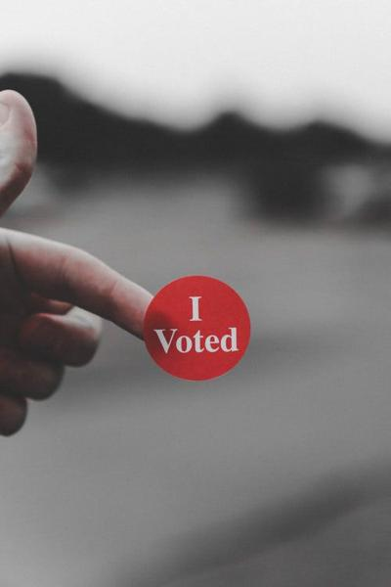
THANK YOU!
Notes:
Thank you for your service to your community, for taking the time to learn and ask questions in training, and for all the hard work you are about to put in on Election Day. Any questions?

Slide 75
Head Judge Details & Procedures
Notes:
Taking a more detailed look at some of the topics we touched on in election judge training…

Slide 76
Head Judge Duties
Lead official in the polling place
Picks up the precinct supplies before the election
Oversees polling place setup and takedown
Administers the election judge oath
Conducts the challenge process
Completes election returns and other forms
Notes:
As leaders in the polling place, head judges must oversee polling place setup and take down, answer questions and solve problems for their team and voters, and ensure the integrity and ease of the election processes taking place in their polling place. In head judge training we are going to go over in the detail some of the subjects that we touched in election judge training, as heads and assistants are the ones who should be handling high level situations and processes.
Other duties include:
Understanding the Election Emergency Plan
Conducts emergency judge training for replacement judges
Understands rules around media in the polling place
Closes the polling place and returns materials
Resolves questions and problems

Slide 77
Authorized Persons While Polls are Open
Persons helping a voter
Children accompanying voters
Vouchers
Observers with written authorization from the secretary of state, county auditor or clerk
Peace officers, if judges request their presence to keep order
Challengers appointed in writing by a political party or nonpartisan candidate
Teachers and elementary/high school students, if participating in a mock election that has been authorized by the secretary of state
Persons making a written complaint
Media
People conducting exit polls can be on the premises, but not in the room where voting occurs
Notes:
Please be aware of who is in your polling place and their conduct, you will have this list of authorized persons with you in the polling place to refer to, but now is the perfect time to ask questions if you have any concerns about who can be in the polling place.

Slide 78
Media
Must present photo ID to the Head Judge and either:
Media credential
Written statement from a local election official
Cannot:
Approach within 6 ft. of someone voting
Converse with voter while in the poll place
Make a list of persons voting or not voting
Interfere with the voting process

Slide 79
In-Person Challenge Procedure
Challenged voter swears oath
Election judge questions voter regarding challenge
If voter answers indicate they are eligible, voter signs roster and votes
If the voter refuses to answer questions or sign the roster, they cannot vote
Cannot come back later in the day and vote
Make note in Roster on voter’s roster line
Election judge records outcome on Oath of Challenge form

Slide 80
Common Roster Notations
A.B. or Absentee Ballot
Voter has already cast an absentee ballot and cannot vote again in person
See ID
Must show proof of residence document
Challenged – Postal Return
Challenged – Voted Out of Precinct
Challenged – Unverifiable
Challenged – Felony
Challenged – Guardianship

Slide 81
Roster Challenge Procedure M.S. 204C.12
Have the voter swear or affirm the oath
Ask the appropriate question in your guide to determine if they are eligible:
Example: felony: ‘Are you on probation or parole for a felony conviction?’
Make a note in the Incident Log
Notes:
Questions on Status: Dept. of Corrections Hotline available at State General Election. Separate Lines for Hennepin/Ramsey. EJ contact County. County contact DOC.

Slide 82
If Ballot Counter Stops Working
With party balance:
Open auxiliary slot on ballot box and contact clerk Voting continues without interruption, then notify the elections office
When counter is working again, put ballots in auxiliary slot into ballot counter
Notes:
During voting hours, it is a party balance activity to open tabulator compartments or touch voted ballots.

Slide 83
Closing the Polls Overview
Process ballots
Complete summary statements
Notes:
Talk about the write-in registration names
Write-in counting process – clerk instructs
# of Judges when combined precinct: divide number of election judges by number of precincts and round to the nearest whole number.

Slide 84
Closing the Polls Overview
Number of Signatures on Roster ≠ Number Ballots in Box?
Review for excess ballots (more votes than voters)
If exists, contact clerk/auditor
If does not exist, proceed
Pack supplies and unused ballots
Seal all used ballots, ensure ballot box is empty
Deliver election materials and results to local officials

Slide 85
THANK YOU HEAD JUDGES!
Notes:
Thank you for your service to your community, for taking the time to learn and ask questions in training, and for the leadership in the polling place and all the hard work you are about to put in on Election Day. Any questions?

