Slide 2
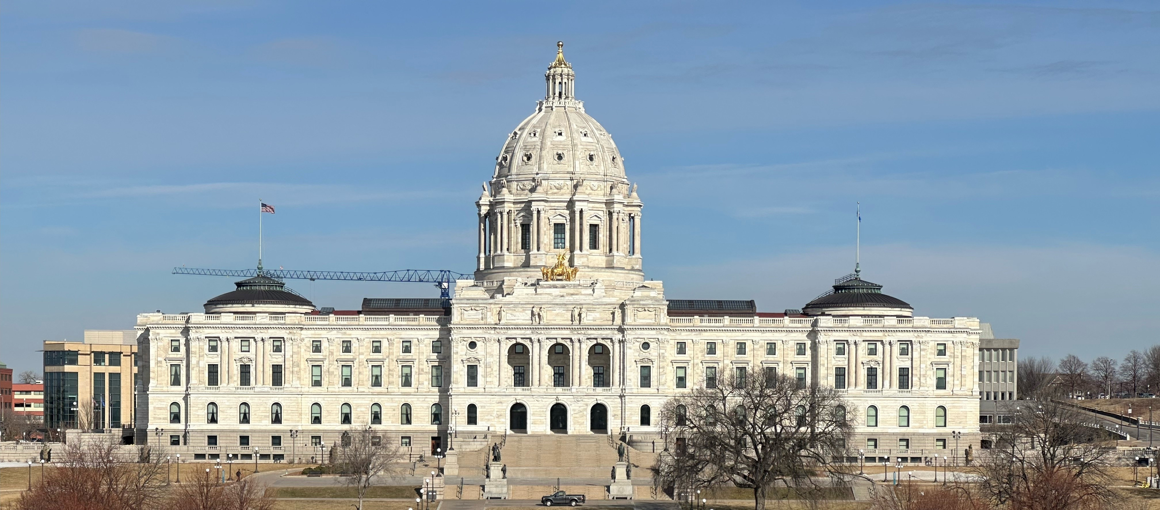
Elections and Voter Outreach Laws
for Postsecondary Institutions
-------------

Slide 3
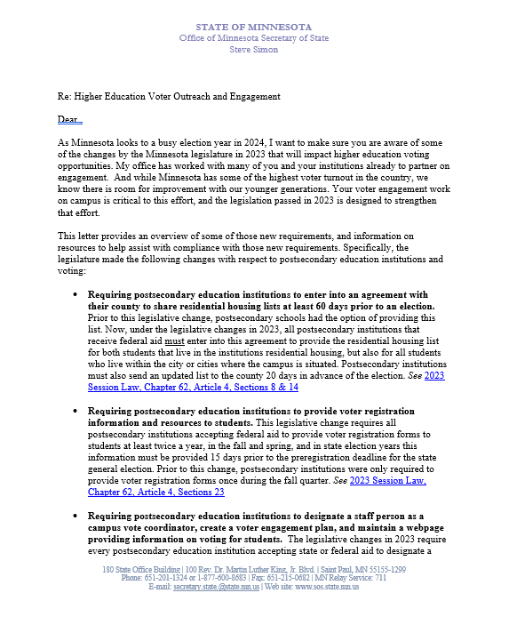
Letter From Secretary Simon Sent Fall 2023

Slide 4
1 2 3 4 5 6 7
Elections Items That
Minnesota Law Says
Colleges and Universities Must Do

Slide 5
1 2 3 4 5 6 7
Please.

Slide 6
1 2 3 4 5 6 7 8
Written agreement to County Auditor
  To provide student housing lists for each election
  By 60 days before the first election of the year.
  Lasts for the calendar year

Slide 7
1 2 3 4 5 6 7 8
Prepare current list of enrolled students
  Living in campus housing
  Living in the campus city/cities (state aid)
  -MAY include up to 10 miles from campus (federal aid)
  Certified (signed off as current and accurate)
  To Auditor each election (not before 20 days prior)

Slide 8
1 2 3 4 5 6 7 8
Provide registration forms to each student
  Spring of each year
  Fall of each year
    Even years: delivered at least 36 days before the state general (November) election.
  If form is provided electronically, email or text must be exclusively about voter registration.

Slide 9
1 2 3 4 5 6 7 8
Consult with campus student government
  Most effective means of:
    Distributing forms
    Facilitating election day registration of students
  To create voter engagement plan/report (#7)

Slide 10
1 2 3 4 5 6 7 8
Web page of voter/elections information
  Voter registration and voting requirements
  Deadlines
  Residency requirements/methods to prove
  Voting options
  Resources for students registered in other states
  Campus vote coordinator name/contact (see #6)
  Voter engagement plan/report (see #7)

Slide 11
1 2 3 4 5 6 7 8
Designate staff Campus Vote Coordinator
  Ensure institution complies requirements
  Consult with campus student government (see #4)

Slide 12
1 2 3 4 5 6 7 8
Submit annual campus voter engagement report/plan by November 30
  Outline efforts to implement these items
  How and when registration forms were distributed
  Campus voter engagement plan

Slide 13
1 2 3 4 5 6 7 (8)
The County Auditor shall notify all
postsecondary educational institutions
about these requirements.

Slide 14
Find all of these and the statutes behind them here:
https://www.sos.state.mn.us/elections-voting/get-involved/postsecondary-elections-resources/
Michael Wall, Youth Voter Outreach Specialist
Michael.Wall@state.mn.us 651-201-6892

