Slide 2
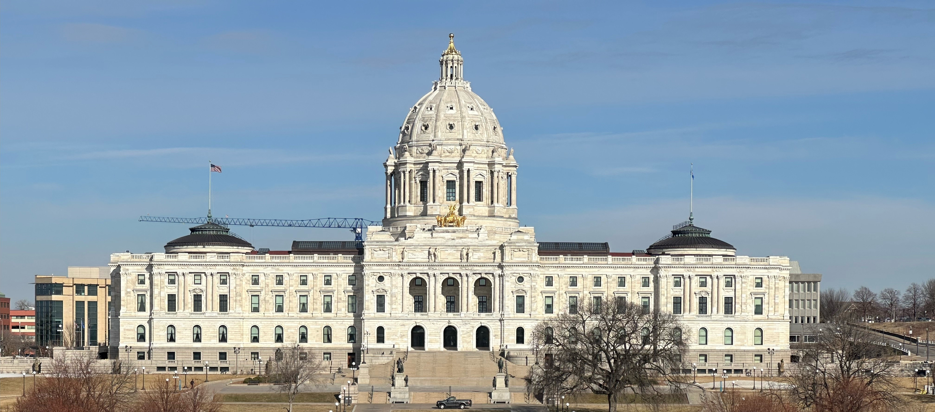
Elections and Voter Outreach Laws
for Postsecondary Institutions
-------------

Slide 3
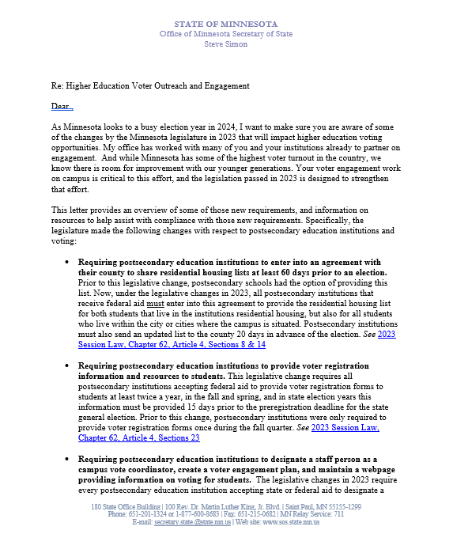
Letter From Secretary Simon Sent Fall 2023

Slide 4
1 2 3 4 5 6 7
Elections Items That
Minnesota Law Says
Colleges and Universities Must Do

Slide 5
1 2 3 4 5 6 7
Please.

Slide 6
1 2 3 4 5 6 7 8
Written agreement to County Auditor
  To provide student housing lists for each election
  By 60 days before the first election of the year.
  Lasts for the calendar year

Slide 7
1 2 3 4 5 6 7 8
Prepare current list of enrolled students
  Living in campus housing
  Living in the campus city/cities (state aid)
  -MAY include up to 10 miles from campus (federal aid)
  Certified (signed off as current and accurate)
  To Auditor each election (at least 20 days prior)

Slide 8
1 2 3 4 5 6 7 8
Provide registration forms to each student
  Spring of each year
  Fall of each year
    Even years: delivered at least 36 days before the state general (November) election.
  If form is provided electronically, email or text must be exclusively about voter registration.

Slide 9
1 2 3 4 5 6 7 8
Consult with campus student government
  Most effective means of:
    Distributing forms
    Facilitating election day registration of students
  To create voter engagement plan/report (#7)

Slide 10
1 2 3 4 5 6 7 8
Web page of voter/elections information
  Voter registration and voting requirements
  Deadlines
  Residency requirements/methods to prove
  Voting options
  Resources for students registered in other states
  Campus vote coordinator name/contact (see #6)
  Voter engagement plan/report (see #7)

Slide 11
1 2 3 4 5 6 7 8
Designate staff Campus Vote Coordinator
  Ensure institution complies requirements
  Consult with campus student government (see #4)

Slide 12
1 2 3 4 5 6 7 8
Submit annual campus voter engagement report/plan by November 30
  Outline efforts to implement these items
  How and when registration forms were distributed
  Campus voter engagement plan

Slide 13
1 2 3 4 5 6 7 (8)
The County Auditor shall notify all
postsecondary educational institutions
about these requirements.

Slide 14
2024 Changes
Student Housing list can be used with any valid form of ID to prove residence. (Not just student ID.)
Paper VRA has space to describe residence (no number)
Witness can be any US citizen 18+ (January 1, 2025)
100+ housing spaces, college can request >0 days temp AB voting location on campus or within .5 miles

Slide 15
QUESTIONS?

Slide 16
Find all of these and the statutes behind them:
https://www.sos.state.mn.us/elections-voting/get-involved/postsecondary-elections-resources/
Find all of these and the statutes behind them:
https://www.sos.state.mn.us/elections-voting/get-involved/postsecondary-elections-resources/
TONS of Great Information at:
https://www.sos.state.mn.us/elections-voting/get-involved
Michael Wall, Youth Voter Outreach Specialist
Michael.Wall@state.mn.us 651-201-6892

