Slide 2
College and University Voter Outreach
-------------

Slide 3
ELECTIONS: Who, When, How

Slide 4
Who can vote? A registered Minnesotan. Well then, who can register?
U.S. citizen
Pre-register at 16; automatically registered at 18. (One can vote if 18 on Election Day.)
Resident of Minnesota for at least 20 days
Not currently incarcerated for a felony conviction.
Voters under guardianship can vote unless a judge specifically revoked their right to vote.

Slide 5
When to update an existing registration
Change of address (even a change in apartments)
Change of name
Have not voted for four years in a row
Released from felony incarceration
Court restored right to vote
To join the Permanent Absentee Voter List (NEW!)

Slide 6
How to Register to Vote
(proving who you are and where you live)
Online at MNVotes.org
Paper form (also available in Amharic, Chinese, English Large Print, Hmong, Karen, Khmer, Lao, Oromo, Somali, Spanish, Russian and Vietnamese. Braille requests: 877-600-8683)

Slide 7
Registration Deadlines
Register ≥3 weeks before Election Day to be on the voter roster on Election Day. OR
Register when you vote
Early/absentee (reg. form automatically added)
On Election Day

Slide 8
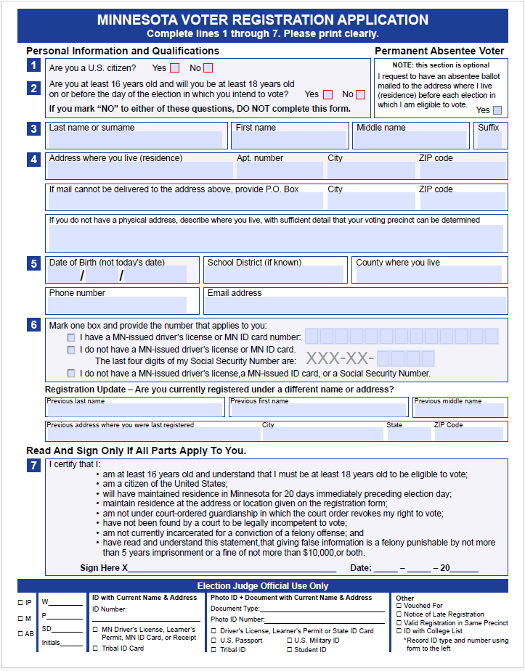
PAPER FORM

Slide 9
Online Registration Tips
You will Need:
-Your email address
-Your Minnesota driver’s license, permit, MN state or tribal ID card number
Don’t own any of these three? You may use the last four digits of your Social Security number.
Don’t own ANY of the four? Paper Form
You will be asked for:
Email (Phone is optional)
Name, Birthdate, DL license or MN ID number (who you are)
Full address (where you live)
An oath (that all information is true)

Slide 10
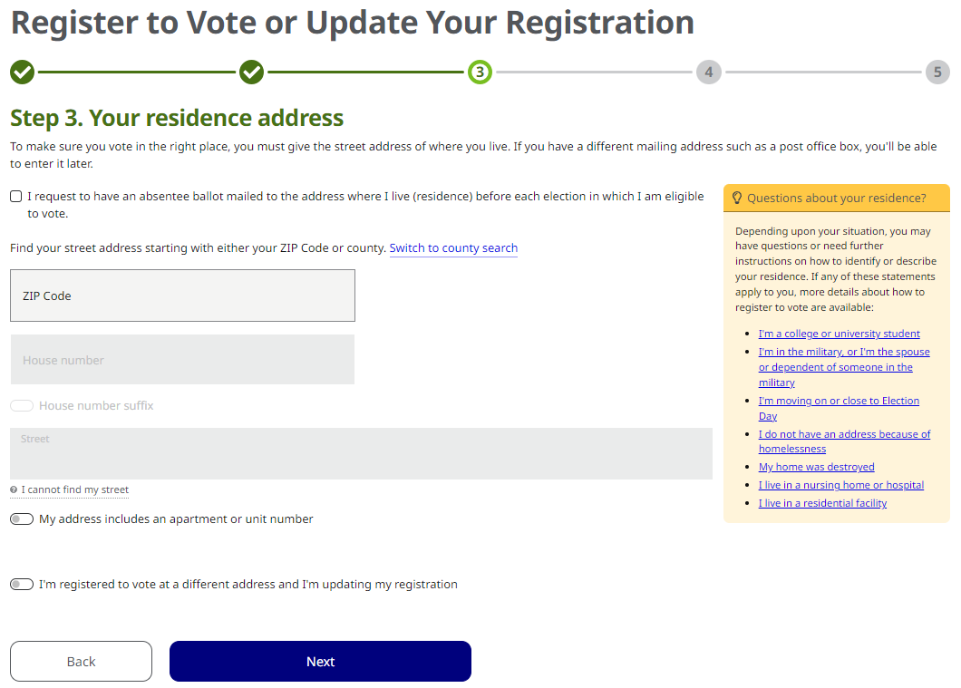
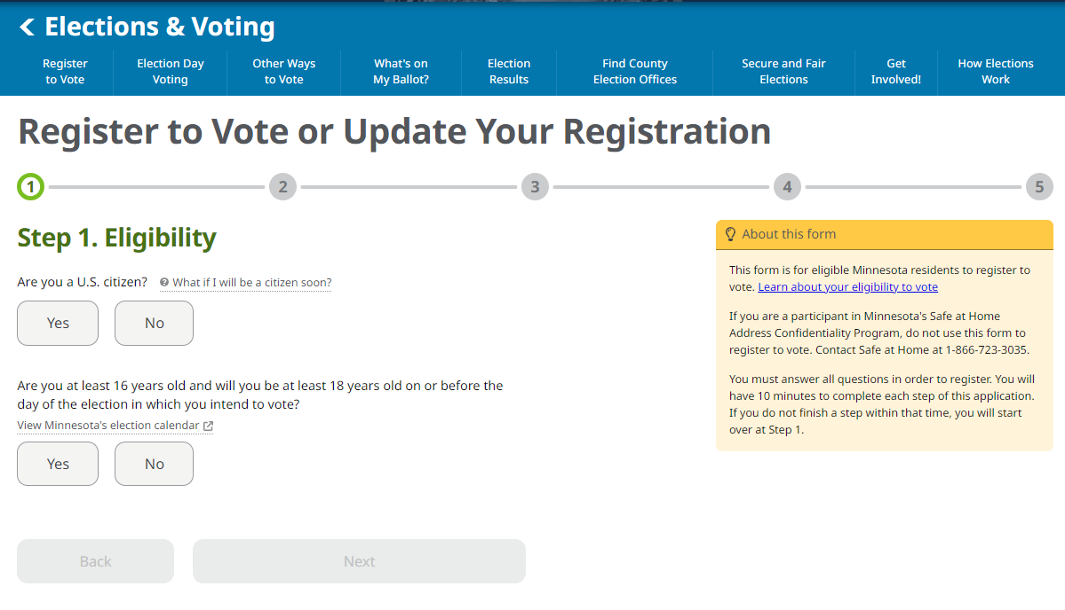
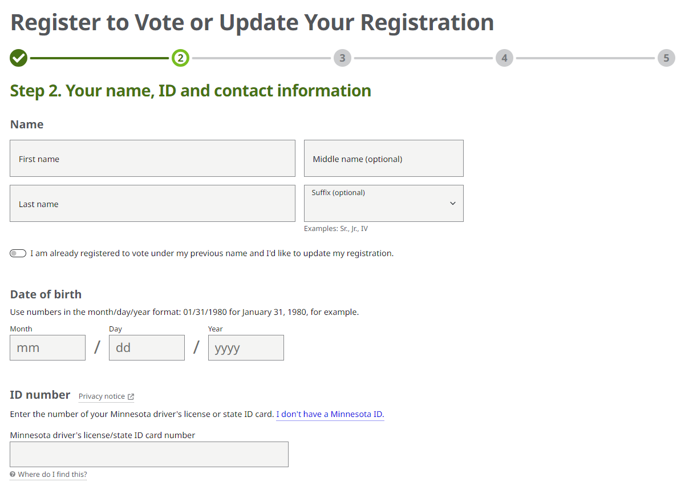
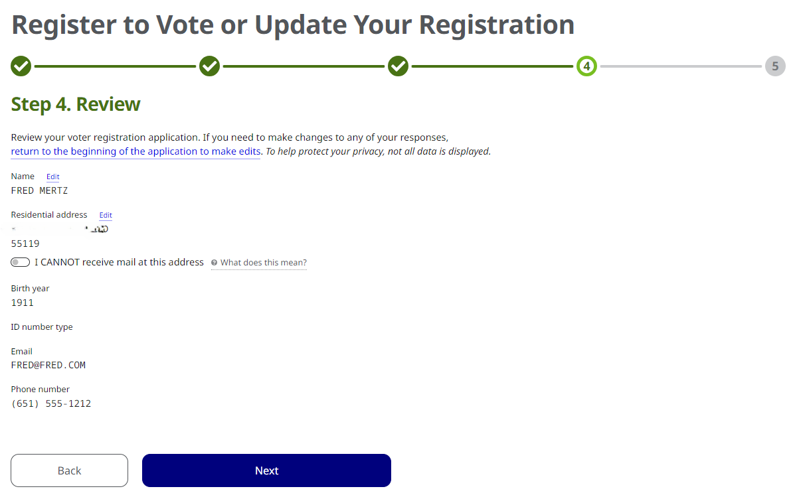
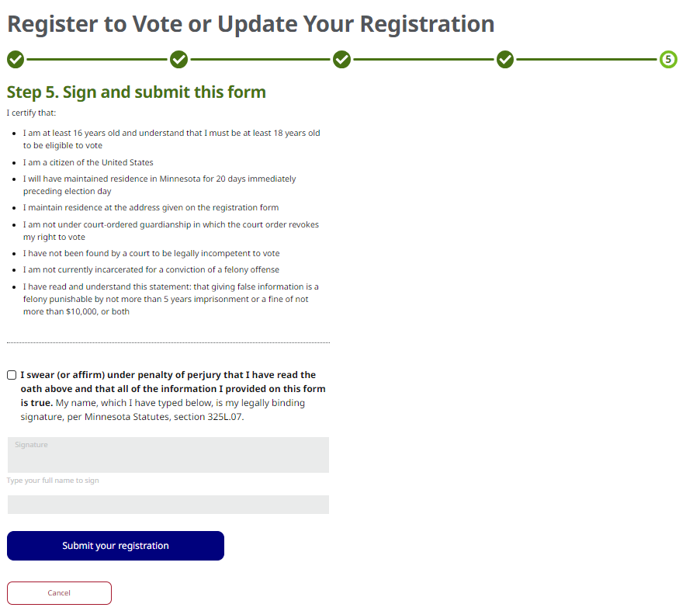
ONLINE REGISTRATION

Slide 11
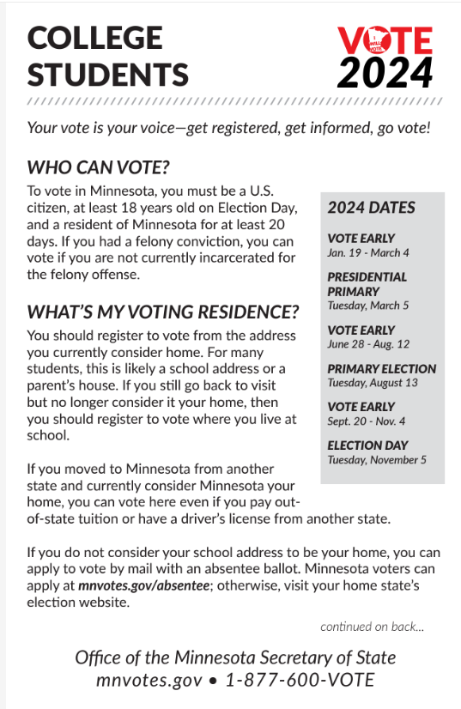
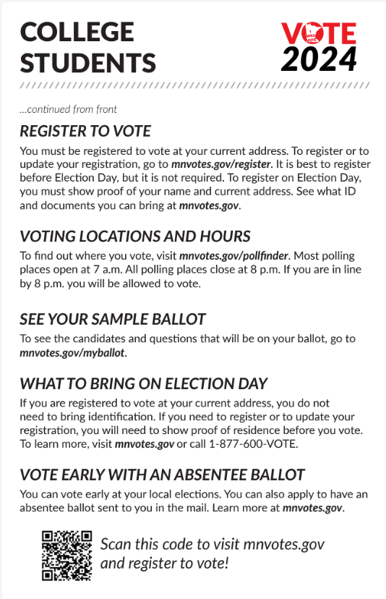
Where do College Students Register? That’s up to them!

Slide 12
COLLEGE STUDENTS
HOME ISN’T WHERE THE HEART IS: The first thing to ask yourself is where you consider home. Is it a) where your family is (“your parents’ house”), OR b) your at-school address?
BUT WHAT IF? (Based on how you answered #1):
If #1a is outside of Minnesota, check that state’s election laws. Start at Vote.gov if you need to.
If #1a is in Minnesota, request an absentee ballot be sent to your school address with this application.
If you are a 1b person, register from that address and either vote early by mail, vote early in person, or find your polling place and vote locally on Election Day.

Slide 13
2024 ELECTIONS CALENDAR

Slide 14
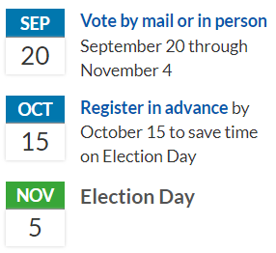
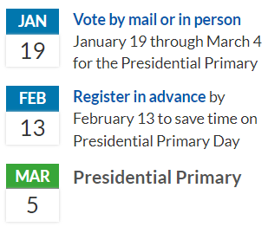
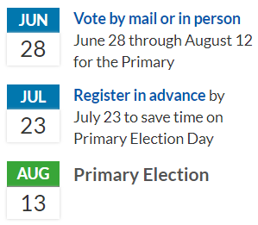

Slide 15
NOVEMBER BALLOT

Slide 16
NOVEMBER BALLOT
All voters on their general election ballot:
U.S. President
U.S. Senator
U.S. Representative
State Representative
Judicial seats
Voters may also have on their ballot:
City Officers
School Board Members
Township Officers
Local ballot questions

Slide 17
3 WAYS TO VOTE:
On Election Day
At your polling place (https://pollfinder.sos.mn.gov/)
Best to register at least 21 days ahead, BUT
Minnesota has Election Day Registration (www.sos.state.mn.us/elections-voting/register-to-vote/register-on-election-day/)
Vote Early By Mail (if you aren’t registered, they send you a registration form too)
Request an absentee ballot for just 2024 election(s) (https://www.sos.state.mn.us/elections-voting/other-ways-to-vote/vote-early-by-mail/) OR
Join the NEW permanent absentee voter list (use the Voter Registration Form; checkbox) (https://www.sos.state.mn.us/elections-voting/register-to-vote/)
3. Vote Early In Person
Every county has at least one early voting location, so check when and when: (https://www.sos.state.mn.us/elections-voting/other-ways-to-vote/vote-early-in-person/ )

Slide 18
VOTING IS POWER
When you don’t vote, someone else has your say
Politicians listen to those who vote.
Call, write, & visit your elected representatives (all levels)
Encourage others to register, research, and vote
HELP others to register, research, and vote!
Ask them, answer questions, share resources, register…
1st-time voters? (SHARE/SHOW/TAKE)

Slide 19
HOW TO RESPOND…
“No one asked me to.”
One of the top reported reasons by young people for NOT voting is that no one asked them to.
“One vote doesn’t matter.” (“My vote doesn’t count.”)
Your vote is your voice
Every large group is made up of individuals; what if everyone stayed away?
BIG elections, sure, but in Minnesota since AT LEAST 2015, every year had an election that tied or was won by one vote

Slide 20
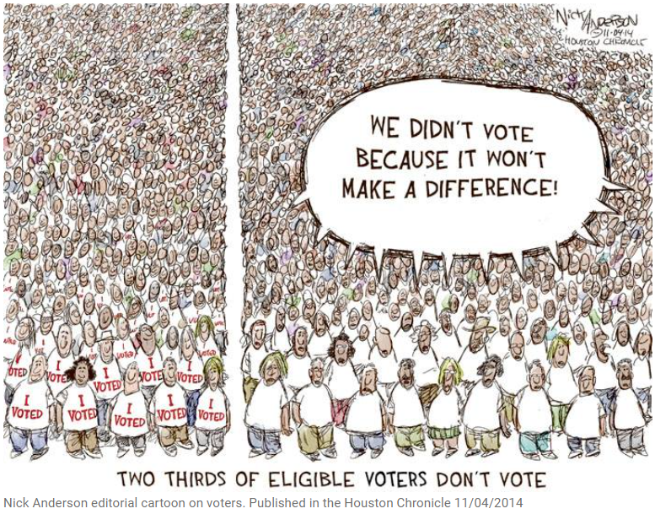

Slide 21
HOW TO RESPOND…
3. “There is too much on the ballot!”
Vote what you know and care about. (National? Local? School board?)
Voting less than 100% doesn’t spoil your ballot
No one will know! (Secret ballot)
The Hope: Someday learn and vote the whole ballot. For now, don’t worry.
4. “I’m not into politics”
Politics are into you! Laws affect you, your life, your family and community.
Ignore parties. Vote ISSUES.
DISCUSS: Look for common ground. Ask about why/motivations rather than focus on difference.

Slide 22
HOW TO RESPOND…
5. “I’m not voting as a protest against the system.”
a. Silence makes no statement. When you don’t speak, others still will.
b. “Failure to vote is not an act of protest, it’s an act of surrender.”
6. “I don’t like any of the candidates.”
BE A PRIMARY VOTER.
Support underdog candidates who are awesome.
Encourage people you know and like to run.
When the menu doesn’t have items you love: ordering nothing leaves you hungry. Sometimes it’s about better, not great (or good).

Slide 23
HOW TO RESPOND…
7. “I don’t want to look stupid.”
Paraphrase of the other major reason reported by young people.
“I’ll vote when I understand it.” When and how will that happen???
Voter EDUCATION raises rate of eligible voters who actually vote. (CIRCLE) Students Voting. NVRD in MN HS.

Slide 24
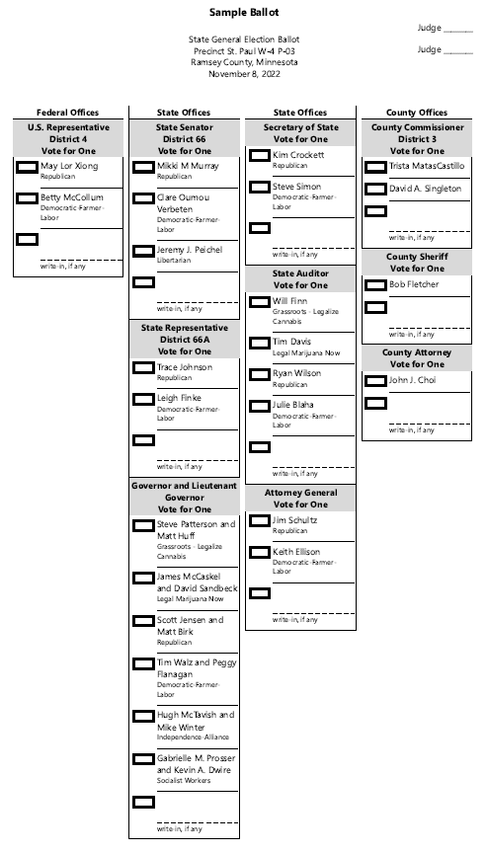
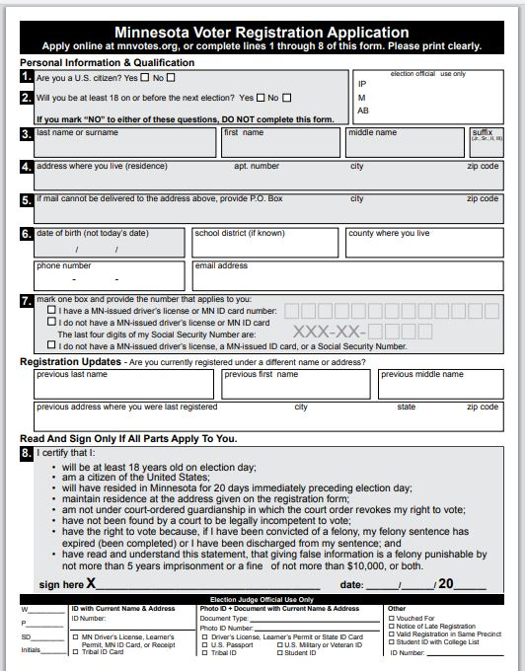
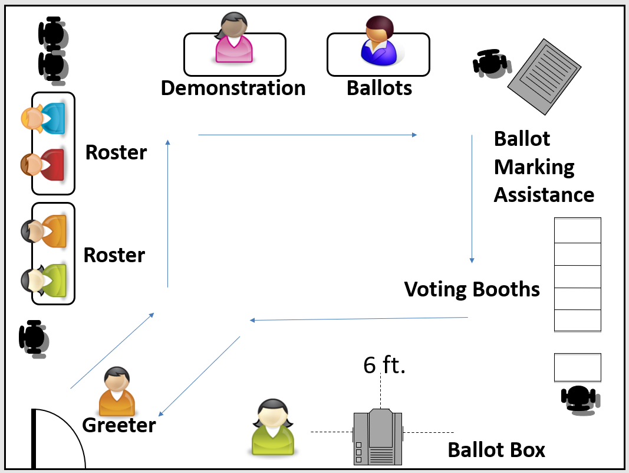
Share the experience, reduce the anxiety:

Slide 25
A nice person will say “Hello!” and make sure you are in the right place.
A nice person will ask your name and address, and check you in, have you sign that it’s you, and give you a receipt.
A nice person will trade you the receipt for a ballot and answer any questions about it.
You vote in privacy.
You place you ballot in the tabulator and get a sticker!

Slide 26
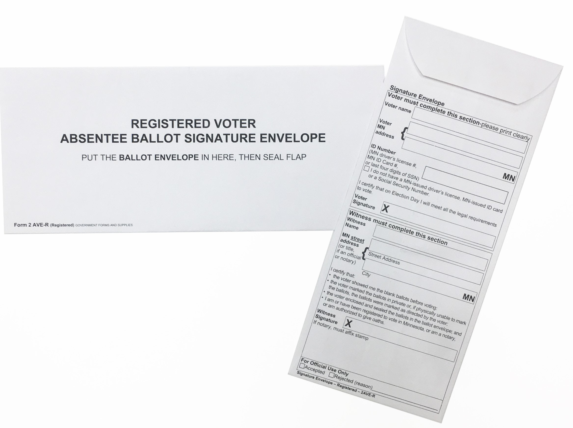
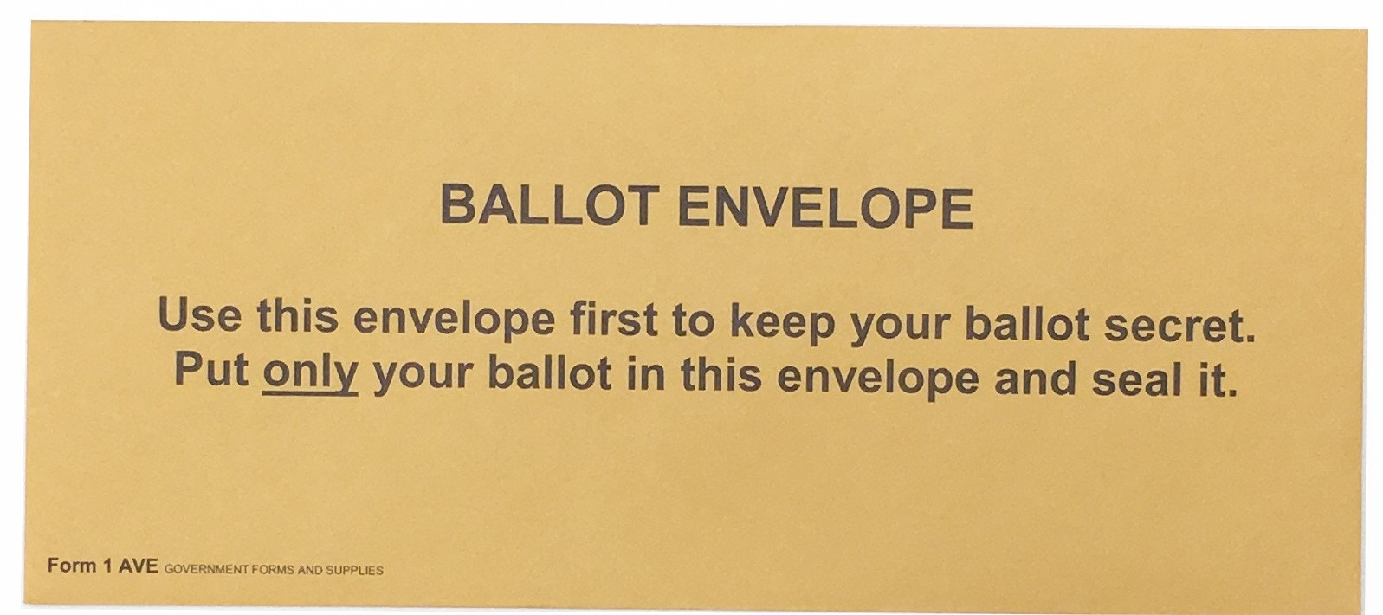
ABSENTEE VOTING: Read the Directions! Witness!

Slide 27
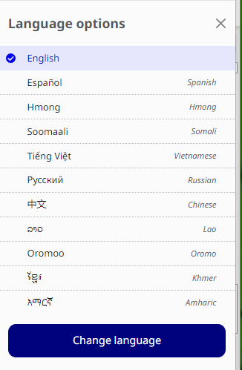
DID YOU KNOW?
Materials and tools in 11 languages

Slide 28
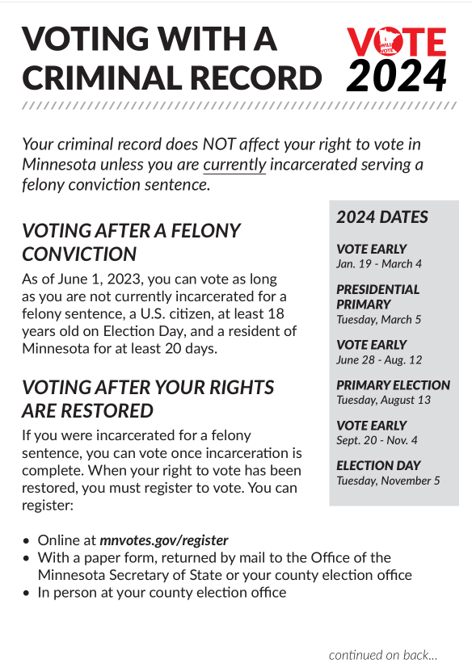
DID YOU KNOW?
Voting with a criminal record:
UPDATE

Slide 29
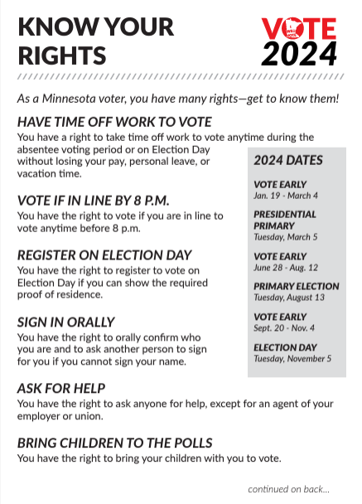
DID YOU KNOW?
Your rights are in Minnesota Law
HAVE TIME OFF WORK TO VOTE REGISTER ON ELECTION DAY
SIGN IN ORALLY ASK FOR HELP
BRING CHILDREN TO THE POLLS VOTE IF UNDER GUARDIANSHIP
VOTE WITHOUT INFLUENCE GET A REPLACEMENT BALLOT
FILE A COMPLAINT BRING A SAMPLE BALLOT
BRING THE VOTER’S BILL OF RIGHTS

Slide 30
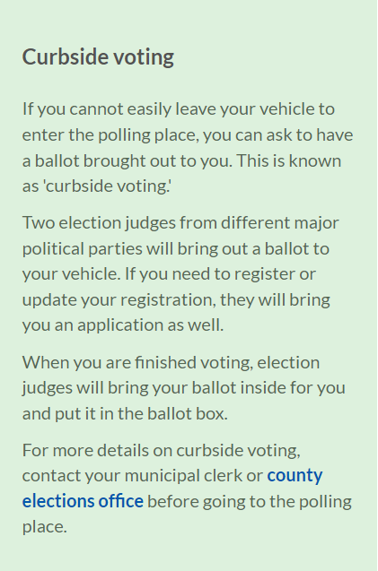
DID YOU KNOW?
You can vote from your car (Curbside Voting)

Slide 31
QUESTIONS?
Michael Wall
Michael.Wall@state.mn.us
651-201-6892

