Slide 1
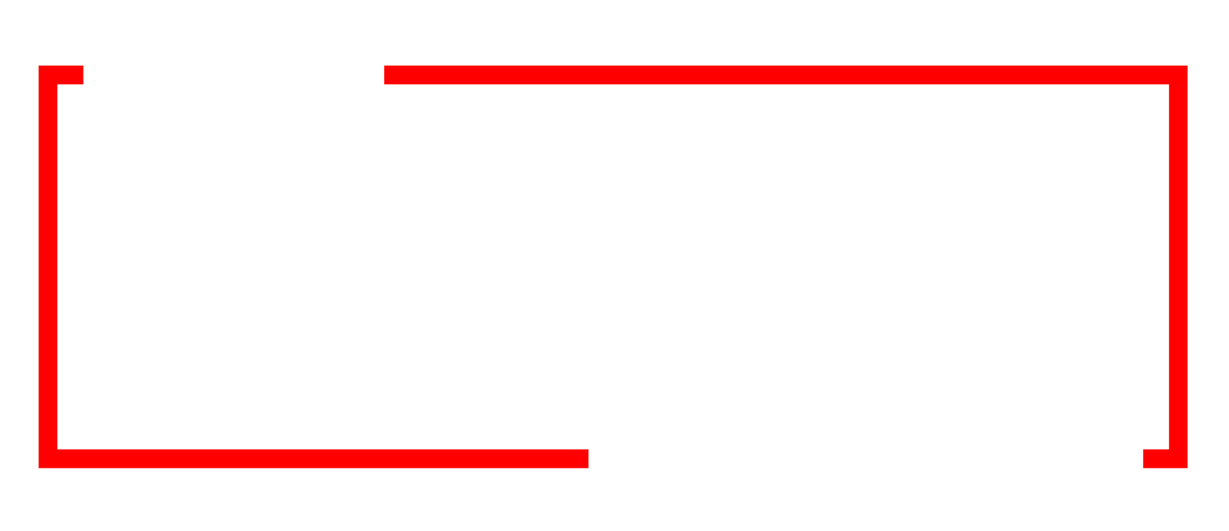

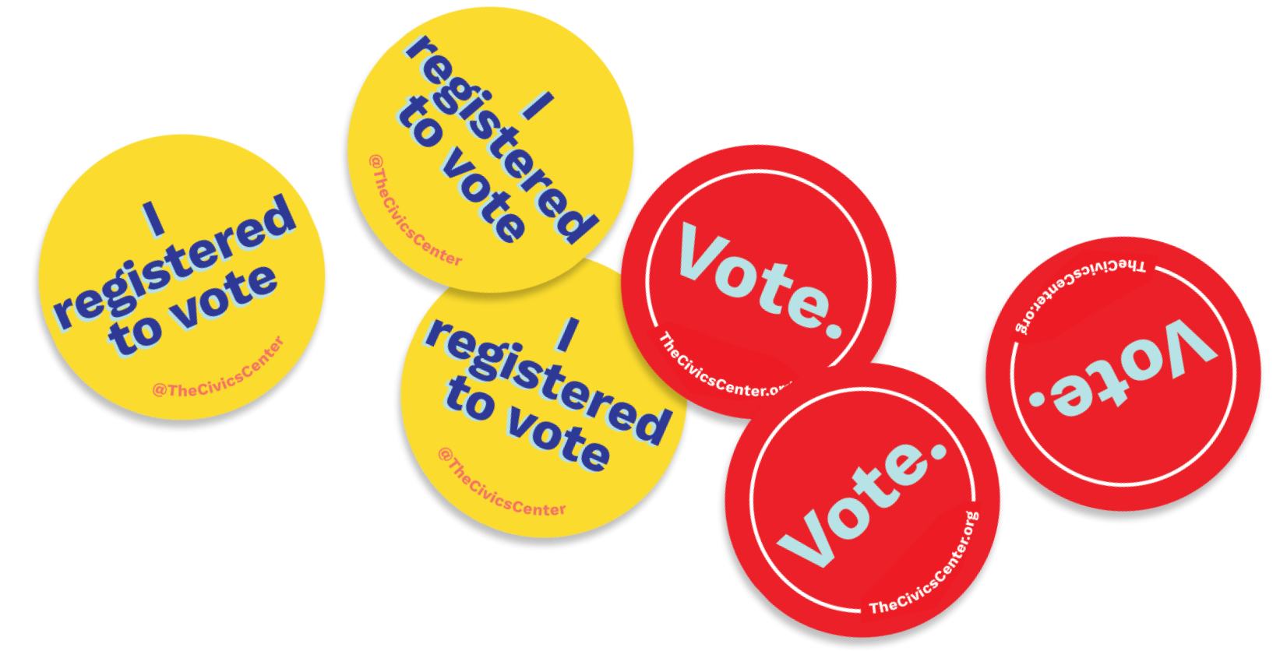
Youth Voter Summit
Youth Voter Summit
High School edition
June 8th, 2026
Notes:
Beth

Slide 2

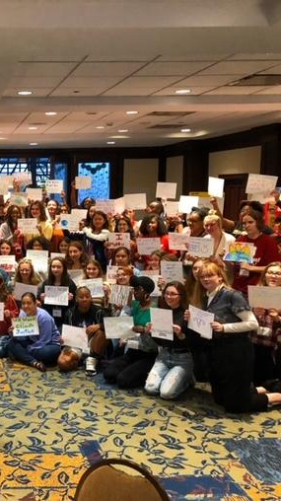

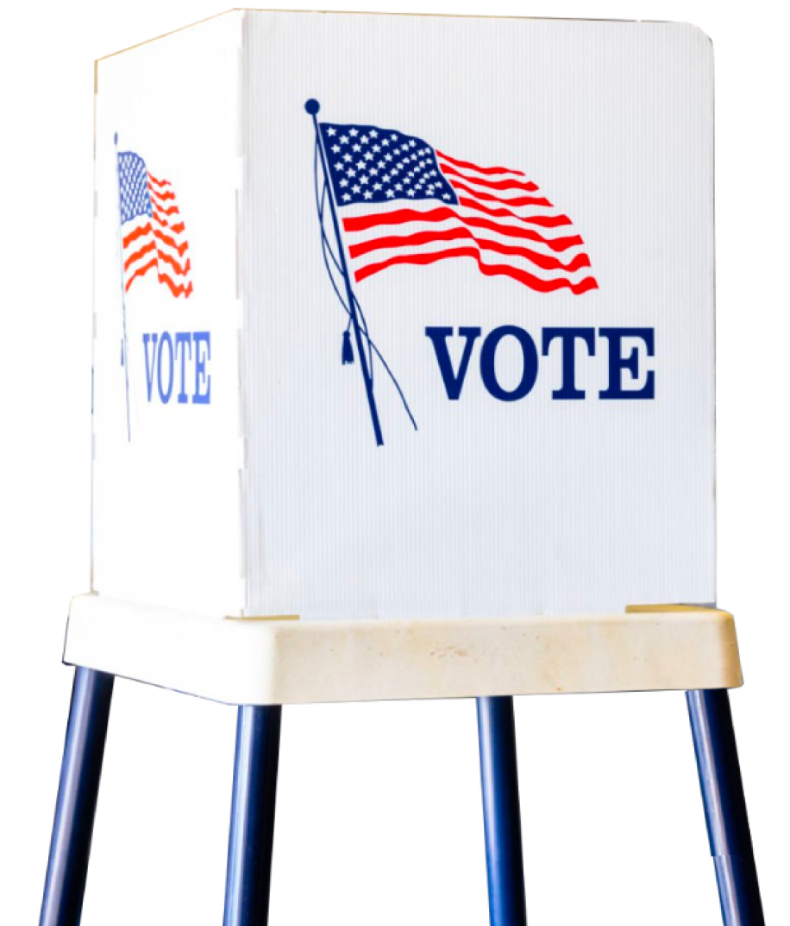
Who is
The Civics Center?
The Civics Center is on a mission to make voter registration part of every high school in the US.
We are a nonpartisan non-profit.

Slide 3
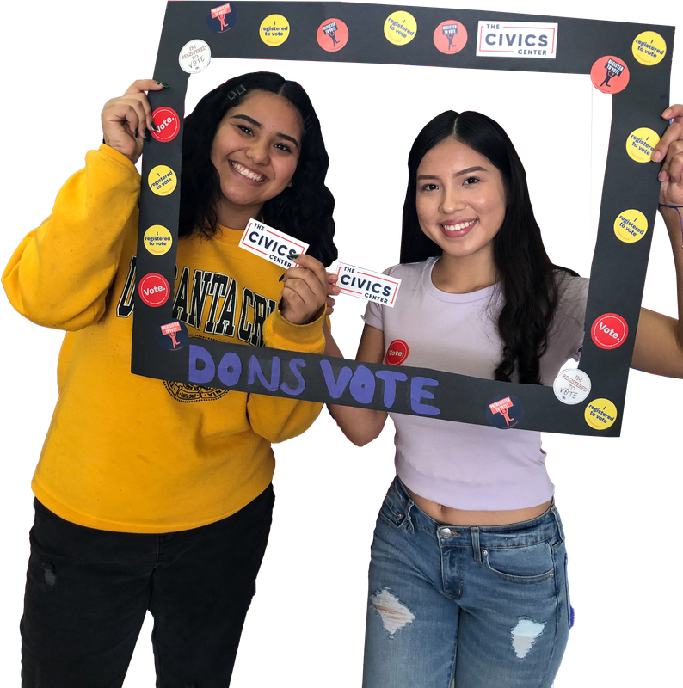
Introductions
Who else is in the room?
Share your:
Name
City/Town and School
Goals for this Workshop

Slide 4
Session #1: The Basics
Session #2: Improving Voter Registration Drives Workshop
Lunch / Keynote Speaker: Secretary of State Steve Simon
Session #3: Engaging your Peers
Session #4: Assets, Issues and Actions for Change Workshop
Agenda

Slide 5
Trivia Question #1
What is the only state that does not require voter registration?

Slide 6
North Dakota
Notes:
https://circle.tufts.edu/latest-research/new-data-nearly-half-youth-voted-2024
Ohio: 8% to Trump in 2020, 6% to Vance in 2022

Slide 7
Trivia Question #2
In how many states can you register to vote before turning 18?
**Registering to vote before you’re old enough to vote is called pre-registration**

Slide 8
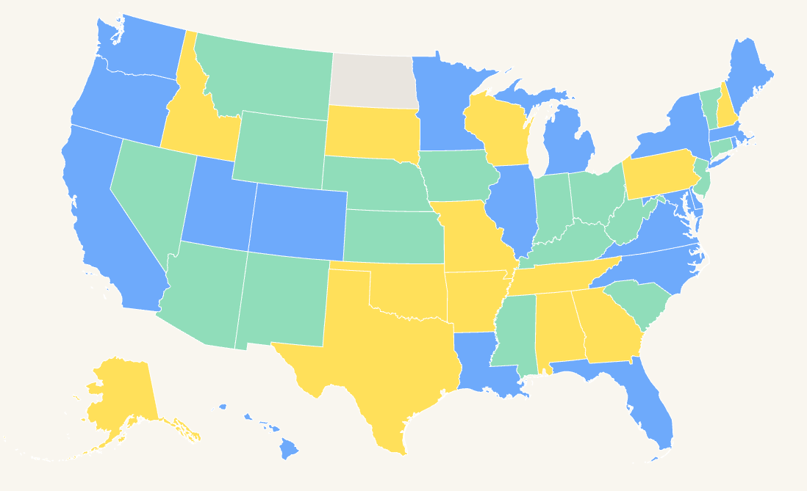


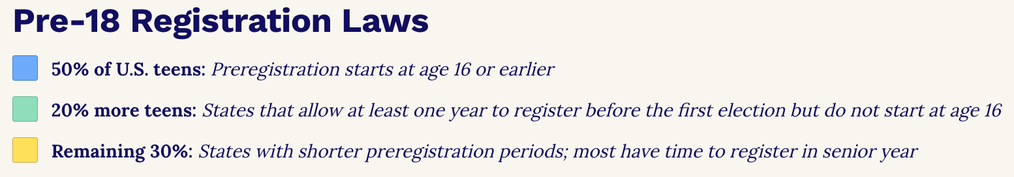
No VR
?
49!
49!
Notes:
If you register before being able to legally vote, you’re basically put into the
https://www.thecivicscenter.org/map

Slide 9
Trivia Question #3
What percent of 18 year olds registered to vote in 2024?
Less than 25%
50-75%
25-50%
More than 75%

Slide 10
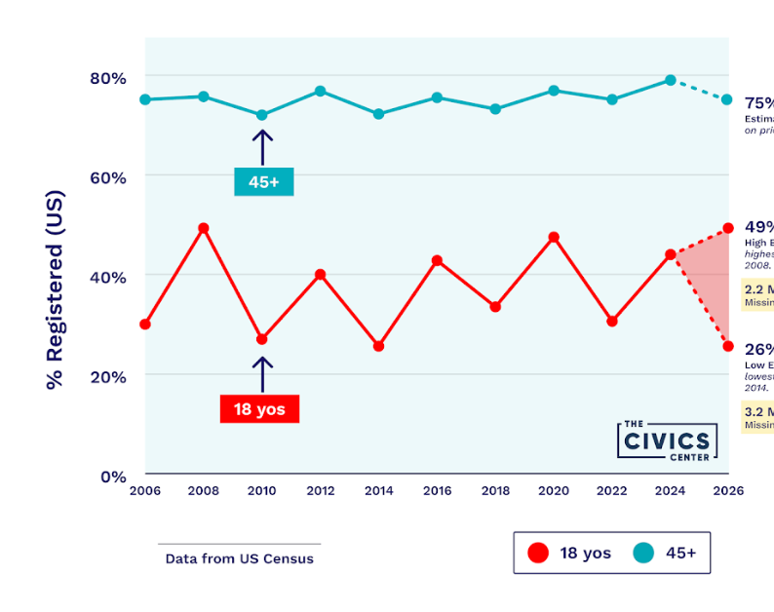
The youngest voters consistently have the lowest registration rates
Notes:
Dotted lines - gap between the lowest turn and the highest turnout since 2006

Slide 11
Trivia Question #4
Of those registered, what percent of 18 yo’s voted?
Less than 25%
50-75%
25-50%
More than 75%

Slide 12
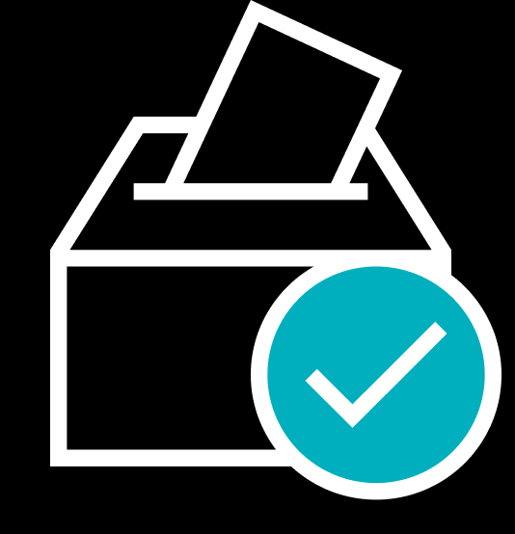
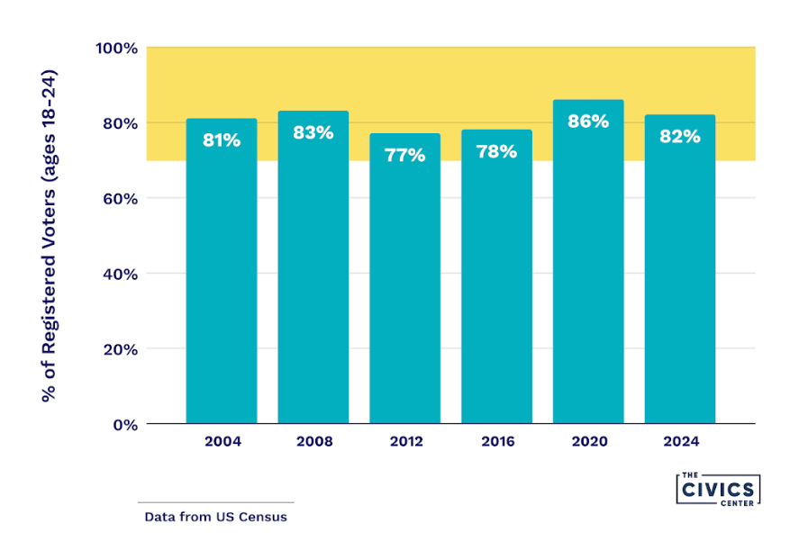
…but they Turnout when they are Registered
In every presidential election from 2004 to 2024, more than 75% of registered 18- to 24-year-olds voted.
Data from US Census

Slide 13

Trivia Question #5
Is Minnesota doing better, the same or worse at youth voter registration than the national average?

Slide 14
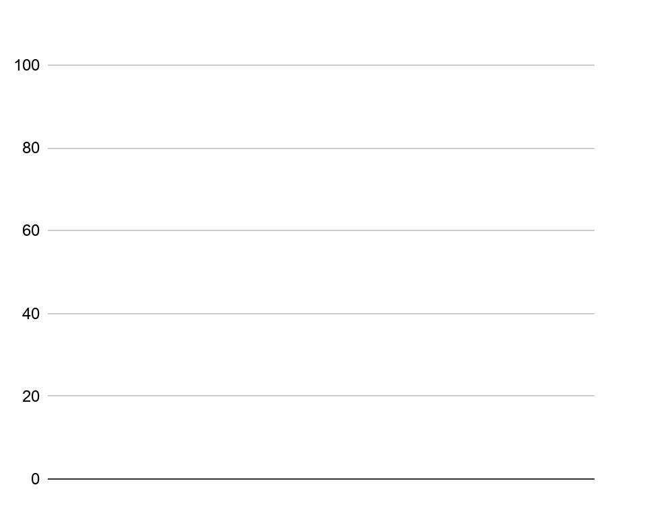
Registration Gap:
Minnesota
as of November 1, 2025
41% of 18 year olds registered to vote***
87% of 45 to 79 year-olds registered to vote
Better! But we don’t know how much better right now…
Sources: State voter file; US Census, American Community Survey.
Notes:
National average is between 30-40%

Slide 15
Trivia Question #6
What were the top five states for youth voter turnout in 2024? (18-29 in this case)

Slide 16

60%
#1 MINNESOTA
62%
58%
#2 MAINE
56%
#3 MICHIGAN
5
5
56%
top
#4 COLORADO
#5 NORTH CAROLINA
Nat. Average: 47%*
Notes:
https://circle.tufts.edu/latest-research/new-data-nearly-half-youth-voted-2024 Animated slide, states appear in reverse order, % appear last.
National averages are not precise

Slide 17
Trivia Question #7
What are the eligibility requirements for registering to vote in Minnesota?

Slide 18
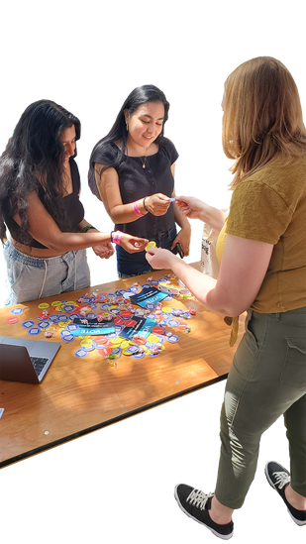

(
)
Pre Registration Eligibility Requirements:
Minnesota
16 years old (can vote at 18)
Are a United States citizen
MN resident for at least 20 days
Not currently incarcerated for a felony conviction or under a court order revoking your right to vote

Slide 19
Trivia Question #8
True or False: You don’t need a photo ID to register to vote in Minnesota

Slide 20
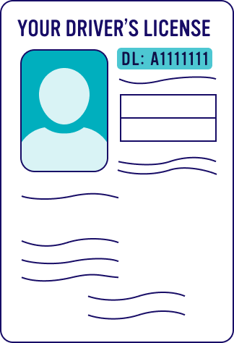
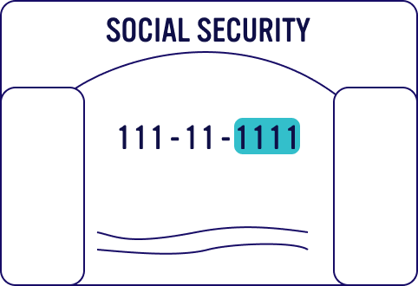
Identification
Options
Driver’s License or Permit Number
or MN-issued ID
DL: A1111111
MN-Issued ID#
Last four digits of SSN#
$100
Provide one year of resources and supplies to a classroom!
$250
Train one student organizer to lead voter registration drives at his/her High School!
$500
Voter engagement packets mailed to 500 Future Voters in Arizona and Pennsylvania!
Social Security Number
*last four digits
$1,000
Fund a scorecard to rank school district voter registration outcomes in the largest counties in Wisconsin, Ohio and North Carolina!
Notes:
#8- they should know that if they register before, they need an ID NUMBER, but when they vote, a physical ID
Find your state’s secretary of state’s website

Slide 21
Trivia Question #9
True or False: If you go to school in another state, you have to register and vote in that state

Slide 22
You choose which address to use. Pay close attention to deadlines regardless of your choice
Home State: Deadline to request an Absentee Ballot
School’s State: Deadline to register
The Rule: Vote from the address that you consider home

Slide 23
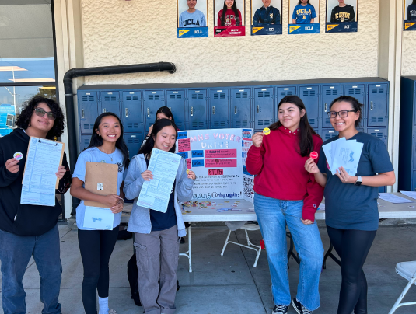
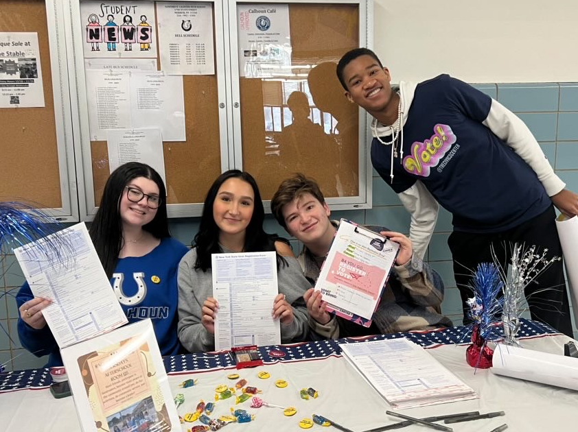

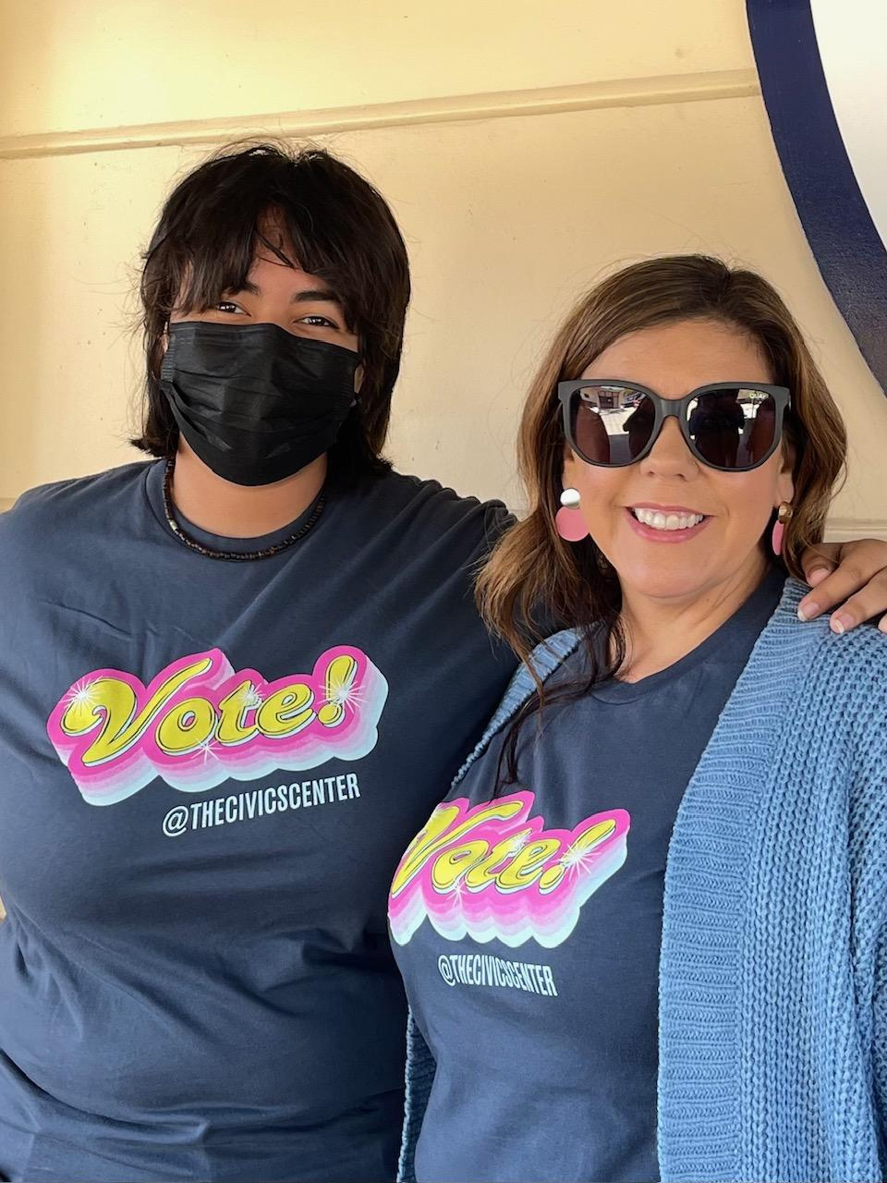
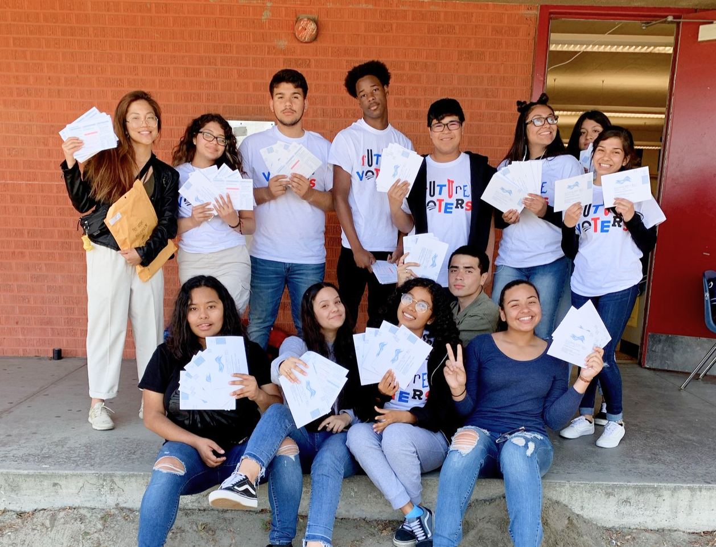
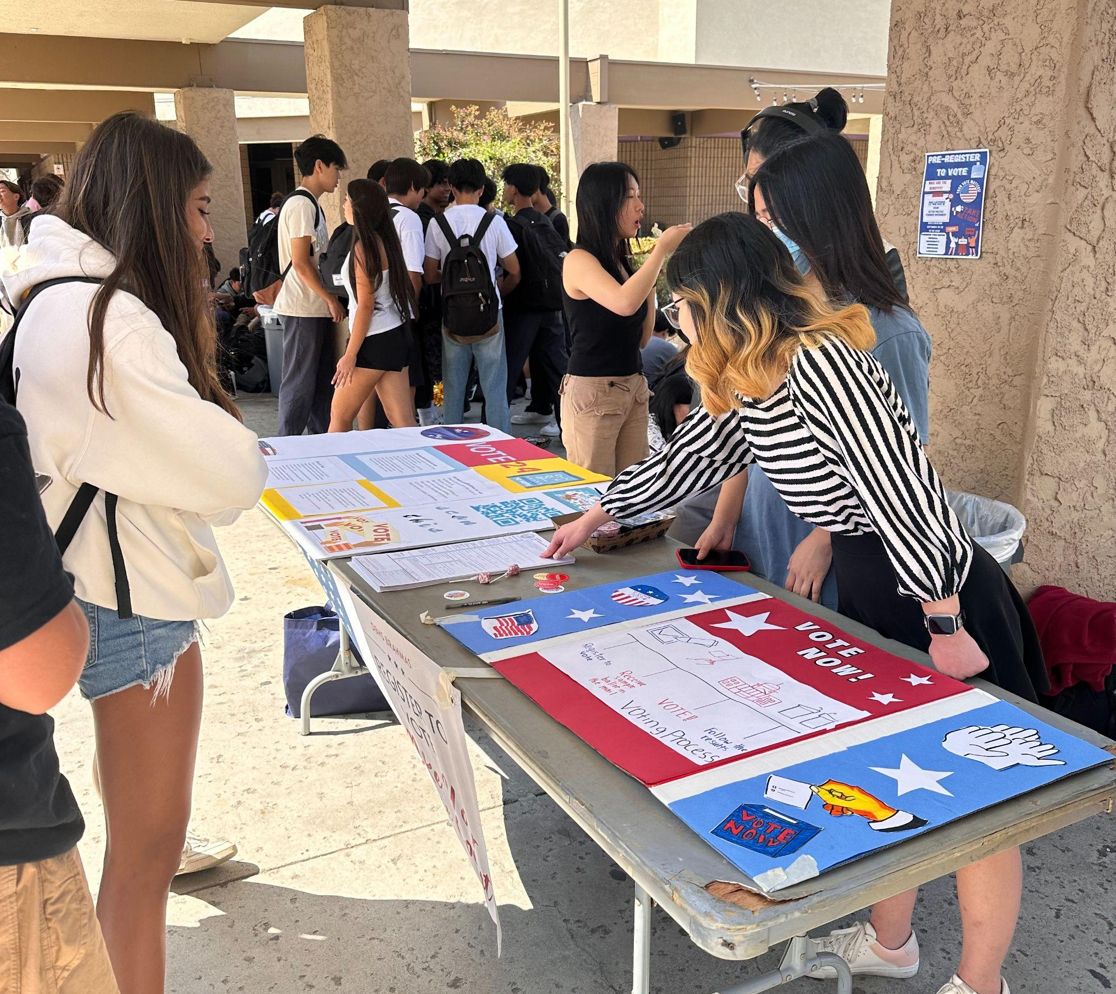
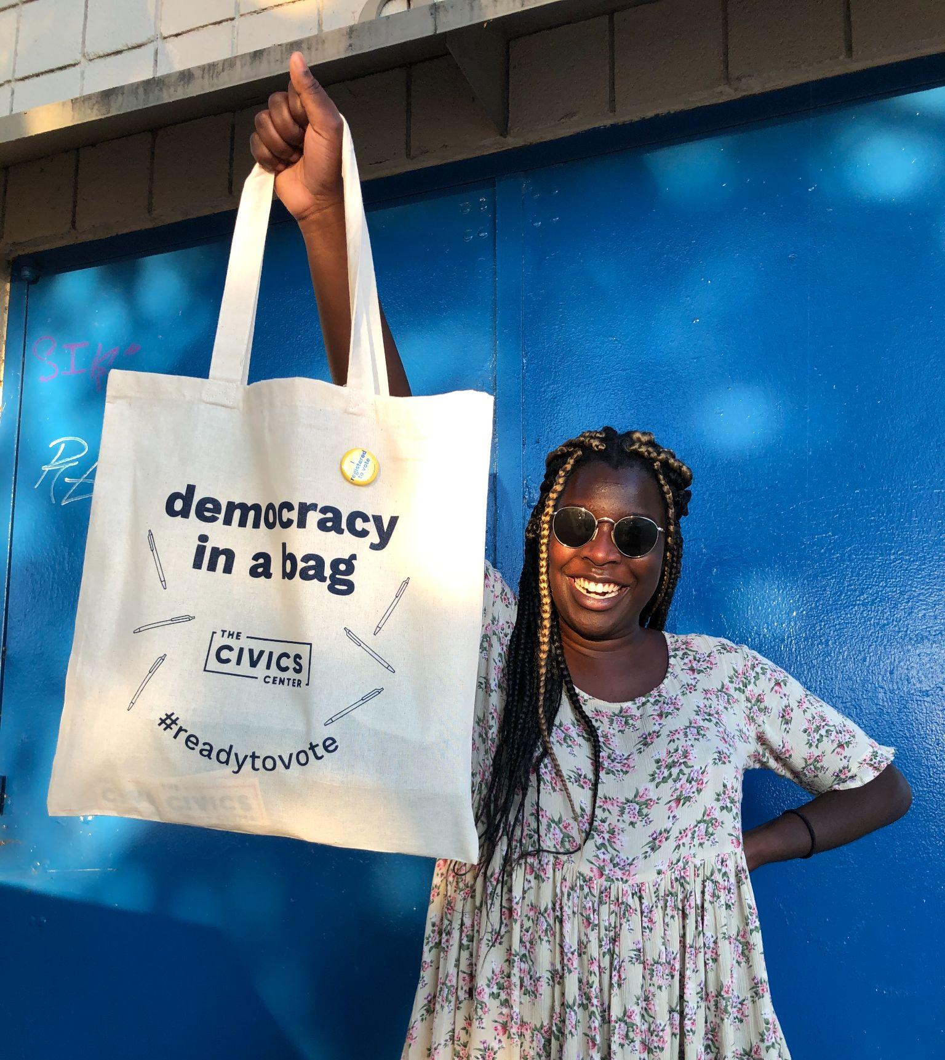
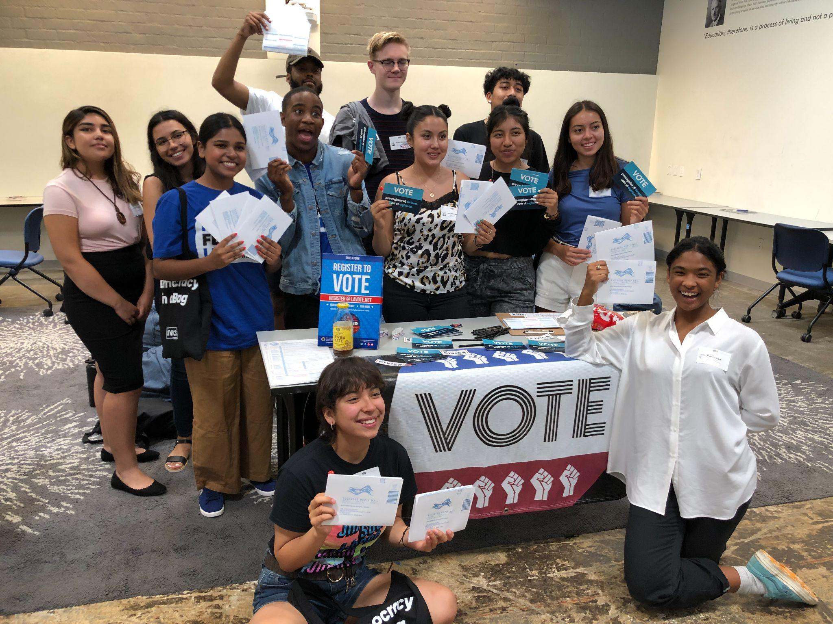
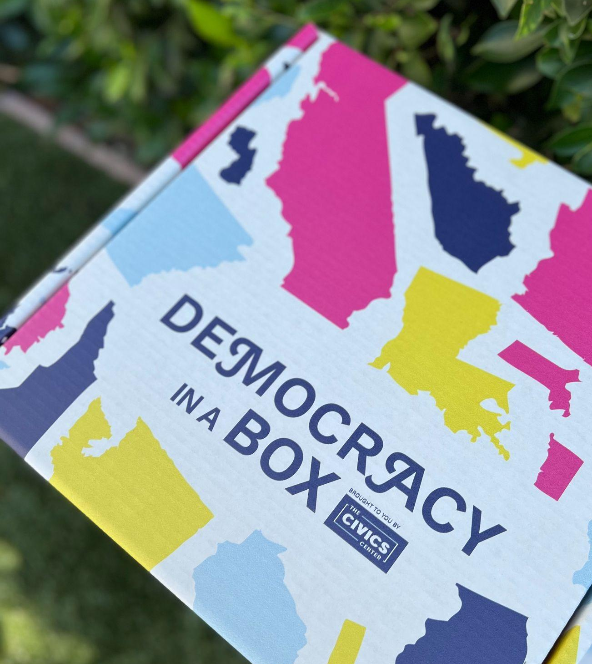
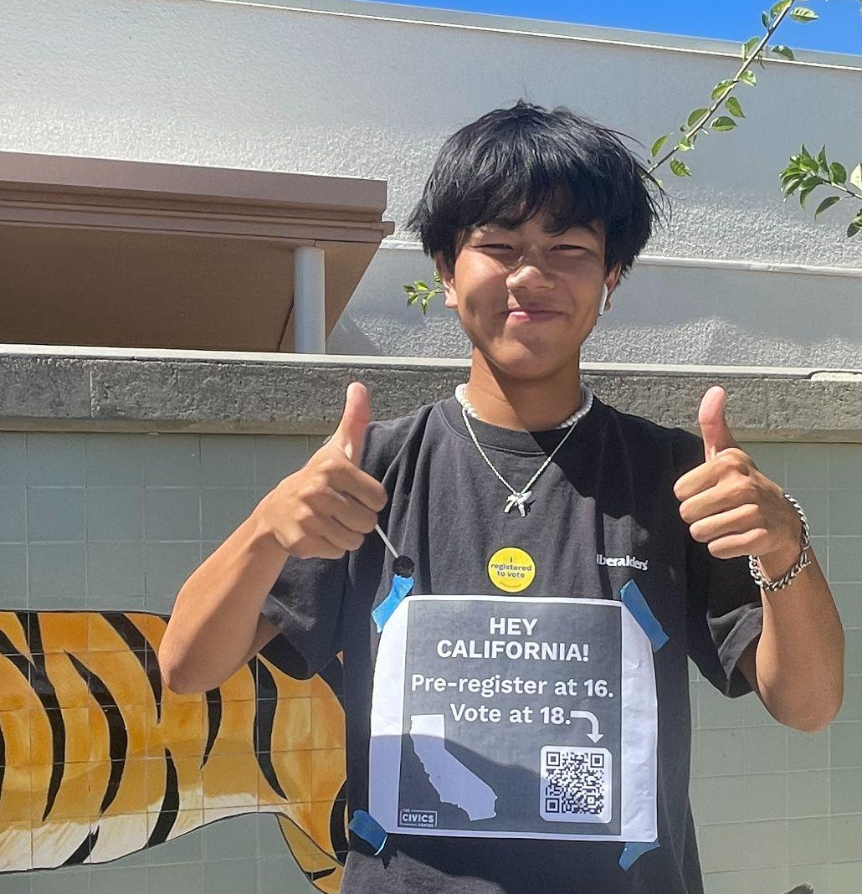
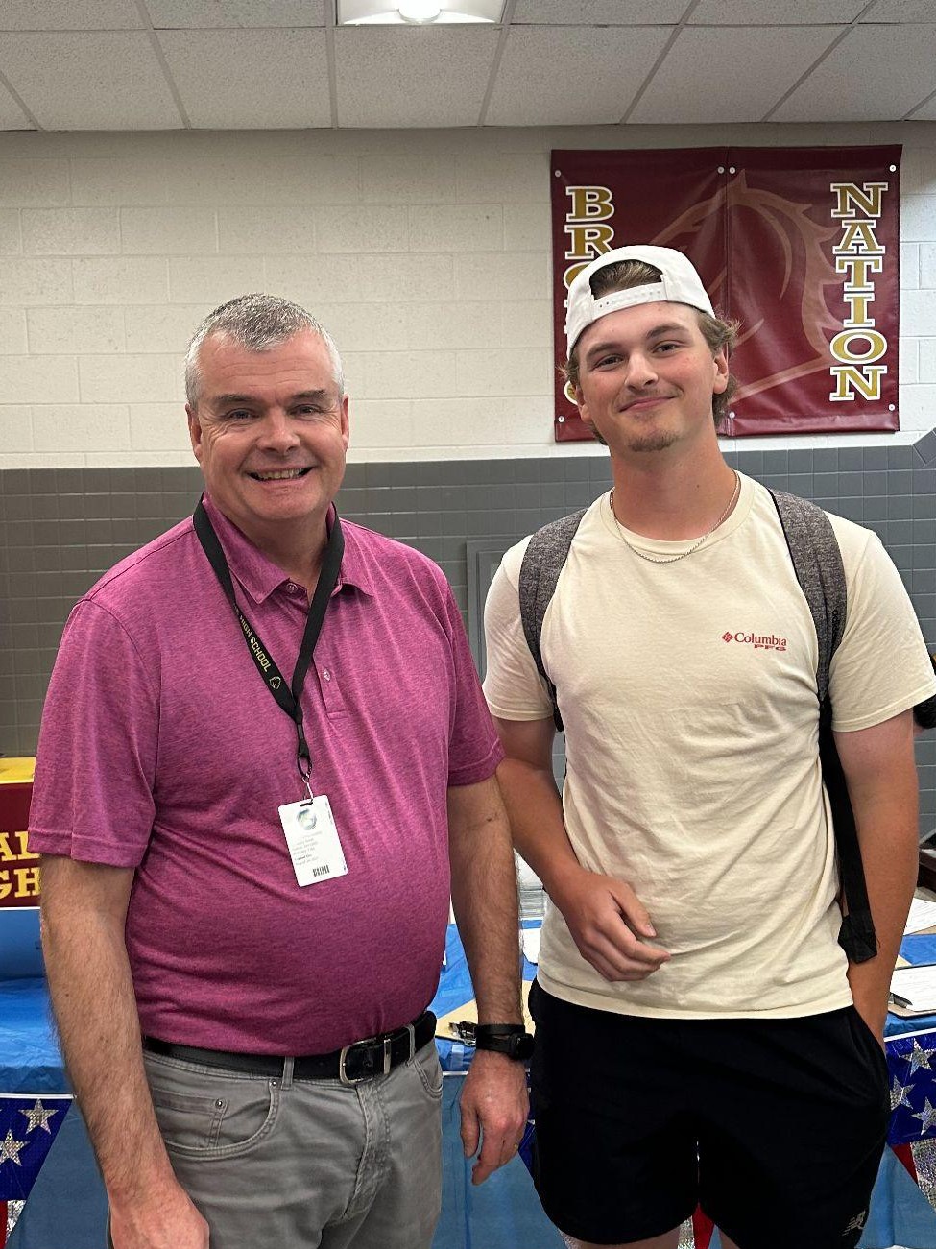
The Basics:
Student-led Voter Registration Drive!
Notes:
Include DAP copy
What’s your school’s context?
Who’re you going to ask?
Want our email templates?
Gather all emails & websites in one document
Request your DIAB

Slide 24

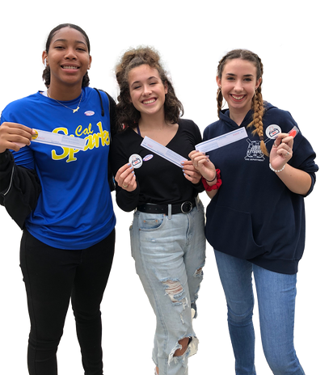
steps to
Designing a Drive
Build a Team & Delegate the work*
Find a teacher, administrator and additional students to collaborate with. Assign focus areas to students
Schedule your Drive
Pick a day, time and location for your drive that works with your school calendar.
Reserve needed materials (tables, chairs)
Coordinate with relevant school staff
Advertise
Create fliers, announcements and social media posts with the time, location and needed IDs
Create a Day-of Plan*
Notes:
* Will go into more depth

Slide 25



How to Delegate
Logistics
When, where and what materials
There are a lot of steps to running a successful drive, but collaborating with a team will help. A lot.
Assign one student to
be in charge of each
type of work
Partnerships
In and outside of the school
Awareness
Get students hyped! And make sure they bring their ID…

Slide 26
Talk it Out:
When you think of a voter registration drive, what do you visualize?

Slide 27
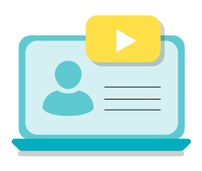
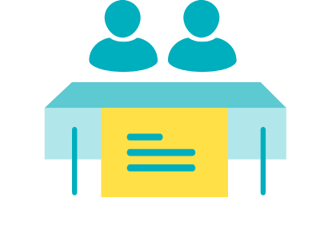
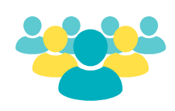
Task: Identify advantages and challenges for each of the following drive types
Tabling at Lunch or School Events
Classroom Presentations
School Assemblies
Notes:
After students have time to reflect, ask as a group: Which approach seems easiest to do? Most effective? Most interesting for your school?

Slide 28

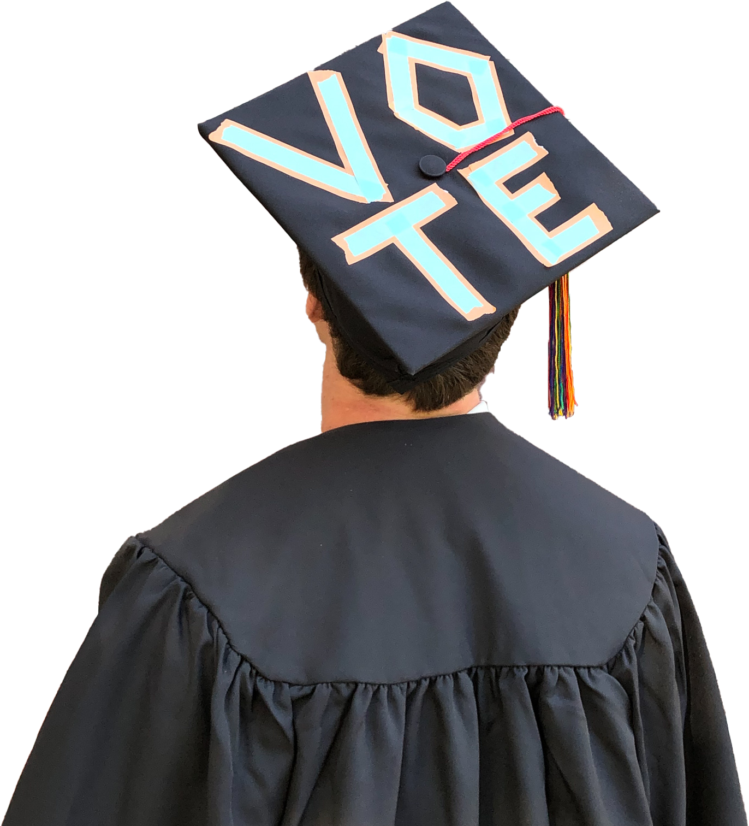
Session #1: The Basics
Session #2: Improving Voter Registration Drives
Session #3: Engaging your Peers
Session #4: Assets, Issues & Actions for Change Workshop

Slide 29
Vocab Check
What does this look like in reality?
When people say “civic engagement” what are they talking about?
What are some examples of civic action or events?
Civic: of or relating to a citizen, a city, citizenship, or community affairs*
* Merriam-Webster: https://www.merriam-webster.com/dictionary/civic *

Slide 30
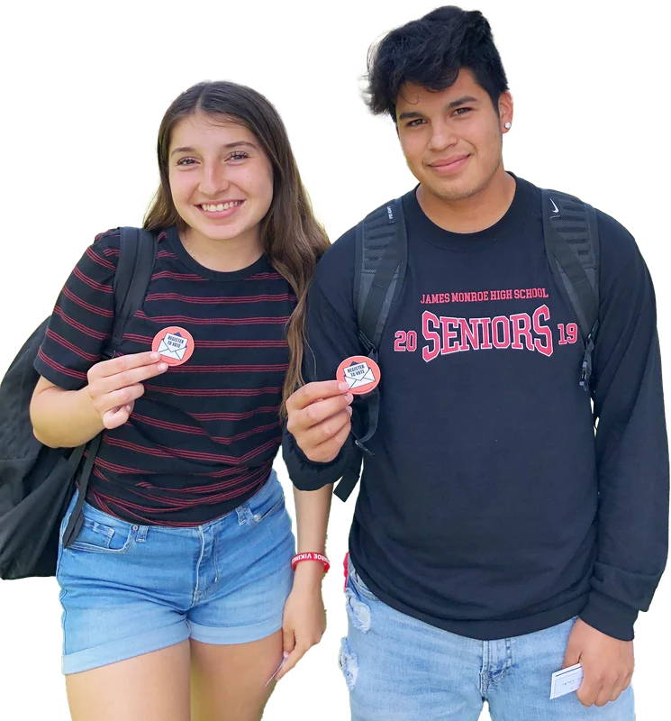
Choose a civic action (voter registration drive, awareness raising campaign, protest, etc) that you’ve done or seen at your school
Identify the goals of the action:
  What problem being addressed?
  Why was this approach used to address the problem?
Describe the event in as much detail as you can recall
* be prepared to discuss *
Reflection
Protocol

Slide 31
Talk it Out:
Describe your event and its goals to your partner/group

Slide 32
Talk it Out:
Describe the successes of your event
Describe the challenges you faced

Slide 33
Talk it Out:
Identify one part of the process that was particularly stressful, or you feel you went ok, but could improve

Slide 34

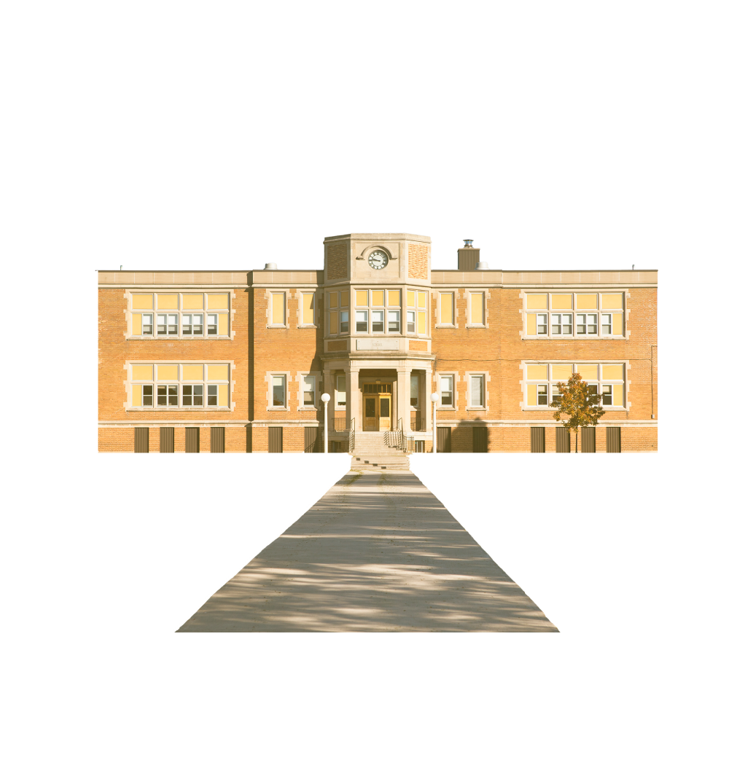


There are always opportunities for improvement when running drives and participating in civic events

Slide 35
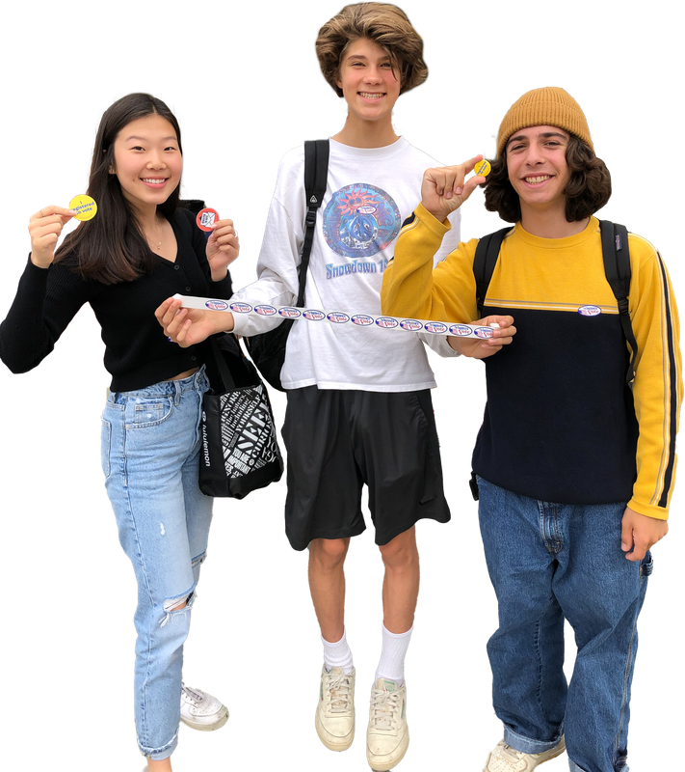
Civic Skills
workshop options
Developing authentic messaging for your audience
Teaching the technical aspects of voter registration and/or voting in Minnesota
Designing an Inclusive Drive

Slide 36
Session #1: The Basics
Session #2: Improving Voter Registration Drives Workshop
Session #3: Engaging your Peers
Session #4: Assets, Issues & Actions for Change Workshop

Slide 37
Vocab Check
Define
Political
vs.
Partisan
How do your definitions compare to Webster’s?
of or relating to government, a government, or the conduct of government
a firm adherent (somebody that strongly supports) to a party, faction, cause, or person
What are the similarities? Differences?
When you’re advocating for specific person/party, you’re having a partisan conversation
When you talk about the government, you’re having a political conversation
* Merriam-Webster, links in notes*
Notes:
Animated Slided
https://www.merriam-webster.com/dictionary/political
https://www.merriam-webster.com/dictionary/partisan

Slide 38
”
Young people don’t vote because they just don’t care. It doesn’t matter to them.
Directions:
Read the Quote
Write down your initial reactions
Write down any questions you have
Who do you think said this?
Do you agree or disagree? Why?
”

Slide 39
Talk it Out:
Why do you think this is such a common belief amongst people of all ages?

Slide 40
We know the trend, we don’t know the cause of it
Address logistical barriers AND help young people connect with elections so they’re in the system and show up
Data from US Census
Notes:
Revisit - point out that we know this trend exists, but we don’t know why. We’ve talked about how to remove barriers, so now we have to talk about engaging young people

Slide 41
Connect opinions to elections
Complicate the belief that their vote doesn’t matter
Counter polarization using approaches tools that reduce the risk of defensiveness
Young people have opinions.
They care.

Slide 42
How comfortable are you at engaging in political conversations with your peers?
Notes:
Follow up questions - what makes you more comfortable? What makes you nervous?

Slide 43
Self Reflection
Productive Political Conversations
In order to get young people to fully participate in civic life, we have to help them make connections, which requires political conversations.
Center Values
Normalize verifying information
These tools can help keep those conversations productive
Keep it Local*
Notes:
Keep it Local will be final session

Slide 44
Self-Reflection
Don’t prepare every response possible.
Instead identify your:
Biases
Triggers
Non-negotiables
Conversation style
Before you start a conversation, make sure you know what you’re bringing to it

Slide 45
Center Values
Productive starting point in disagreements
Can complicate your own understanding of the issue
Builds some trust
Find the values at the center of a peer’s opinion,
even if you disagree

Slide 46
Values List
Freedom
Diversity
Cooperation
Equality
Security
Self-reliance
Stability
Democracy
Rank the list of values in order from most important to least important
1
2
Compare with neighbors. Notice similarities and differences.
3
Look for the source of disagreements.
Discuss: Could any of these values create tension?
4

Slide 47
Misinformation: Incorrect information, but it’s not created/shared with the intent to cause harm
Disinformation: Incorrect information created/shared with intent to cause harm
Malinformation: Information based on fact but used out of context with intent to mislead, harm or manipulate.
Verifying Information
Clarifying Language

Slide 48
Talk it Out:
Where do you get most of your new information from? BE HONEST!

Slide 49
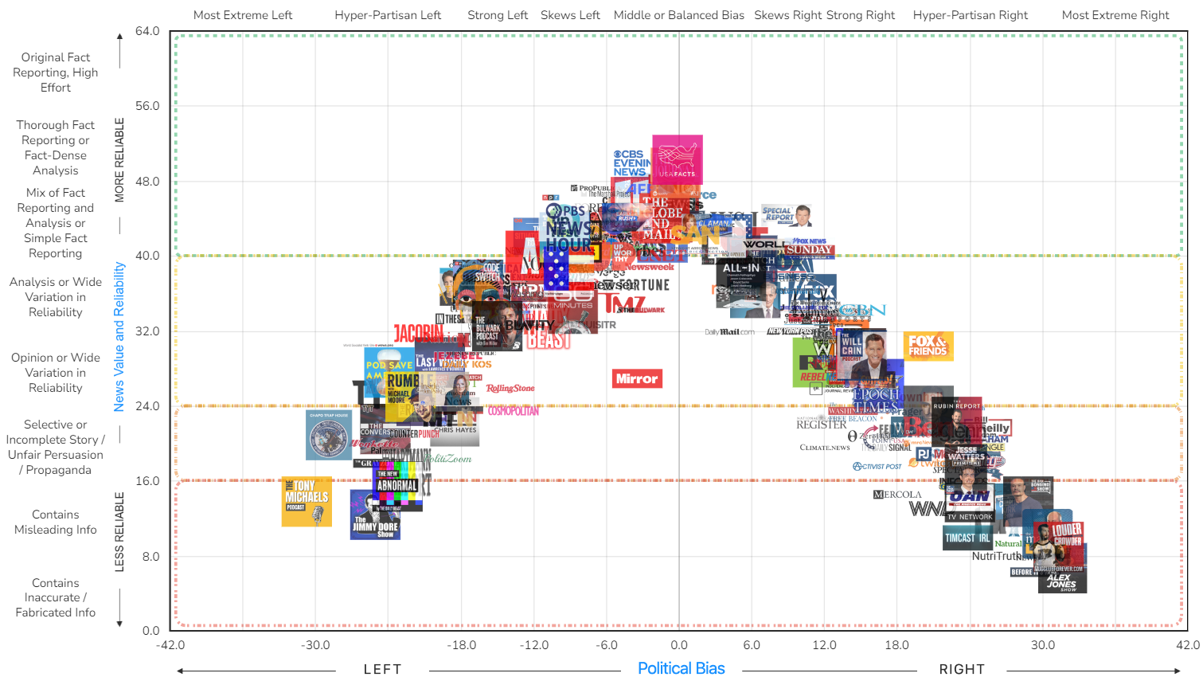
You can’t avoid biased information so name and manage it
https://adfontesmedia.com/interactive-media-bias-chart/

Slide 50
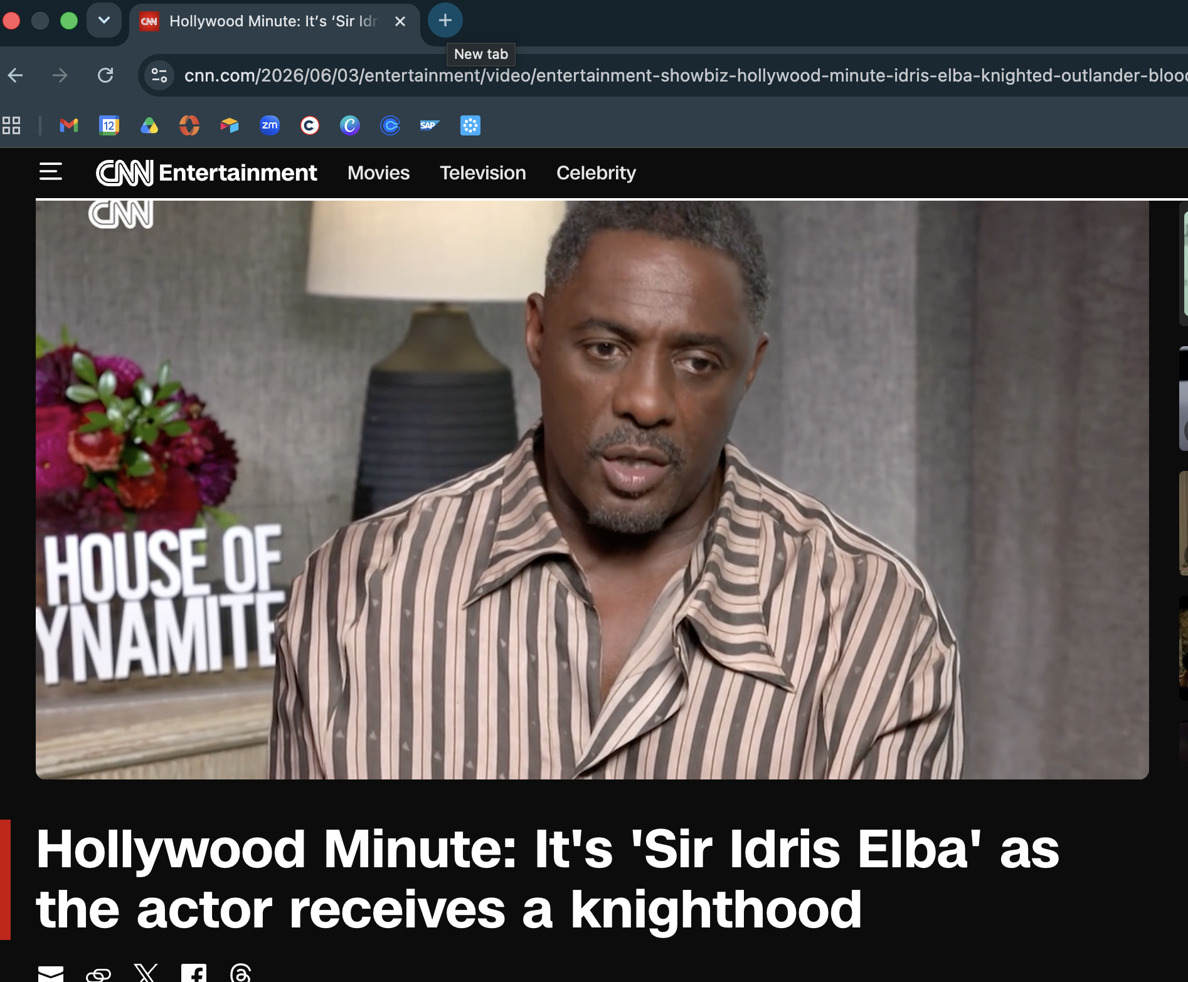
Read Laterally
(open a new tab, see what others are saying)
Notes:
Pic is nothing in particular, using something light as an example

Slide 51
Talk it Out:
What do you do when somebody says something that you’re not sure is true or you know is false?

Slide 52
Self-Reflection
Model Best Practices
List your sources in the moment “I heard on…”
Invite peers to fact check you, especially when info is from socials/somebody else
“I’ve heard that, but I understood it as…”
Ask Questions
“Interesting, what’s your source on that?”
Dealing with mis/dis/mal information can be tricky in the moment

Slide 53
Session #1: The Basics
Session #2: Improving Voter Registration Drives Workshop
Session #3: Engaging your Peers
Session #4: Assets, Issues & Actions for Change Workshop

Slide 54
Talk it Out:
What is the actual purpose of governments?

Slide 55
Center Values
In the United States…
Citizens choose who manages our communities through elections
We have multiple options when we don’t like how it’s being managed
Shifting focus from the person to how issues are managed can be more productive
At the most basic level, governments exist to manage communities
Notes:
Our values and beliefs on the government

Slide 56
Talk it Out:
What is a community?

Slide 57
What does unity mean to you? What does it look like at your school?
What factors could unify a body of individuals to create a community?
What communities are you a member of?
Community: a unified body of individuals*
* Merriam-Webster: https://www.merriam-webster.com/dictionary/community *
Notes:
The presenter or slides should emphasize that unity does not equate to homogeneity, ideological or otherwise.

Slide 58
For the rest of this session, we’re going to focus on a community we’re all familiar with: Minnesotans
1
Independently, write down your favorite things about living in Minnesota
Focus on one of your favorites - How does that aspect of being part of Minnesota bring value to your life?
2
Compare your list with a neighbor. What’s similar? What’s different? Anything you want to add to your list now?
Decide on 1-2 things from your list to share with the group
3
4
Notes:
Animated Slide

Slide 59
Rational
Don’t forget to to celebrate your shared communities. In fact, start there.
Starting with community assets…
Reduces discomfort and defensiveness, gives time to build trust

Slide 60
For the rest of this session, we’re going to focus on a community we’re all familiar with: Minnesotans
1
With a Partner: Choose one of the assets we just discussed.
Discuss: How do you think that asset was created? What
conditions or actions allowed it to be possible?
2
Discuss: Could we use any of those factors to improve something in our community that isn’t working?
3
Notes:
Animated Slide

Slide 61
Rational
Don’t forget to to celebrate your shared communities. In fact, start there.
Starting with community assets…
Reduces discomfort and defensiveness, gives time to build trust
Can demonstrate effective strategies for improving your community

Slide 62
For the rest of this session, we’re going to focus on a community we’re all familiar with: Minnesotans
1
Make a list of the important issues that impact you and your community
Compare your list with a neighbor. Choose two issues to add to the group list.
2
Notes:
Animated Slide

Slide 63
Vibe Check
Is the government currently managing the issue in an effective way?
Notes:
After an opportunity to share, ask, which government were you thinking about?

Slide 64
FEDERAL
+ 575 Tribal Governments
STATE
We often think Federally
Think Local Instead
LOCAL
Notes:
11 tribal governments in Minnesota. Ask, which level of government do you think is best equipped to deal with the issue you’ve focused on? What role can the local governments play?
Do a second vibe check

Slide 65
Talk it Out:
Think about the creation of the community assets you explored.
Is there anything you can use from those community assets to improve the issue you focused on?

Slide 66
If you want the government to manage the issues you care about, register early and vote
Get into the system so candidates work for your vote
Vote for candidates that share your values & priorities
Remove representatives that are not meeting your expectations
Notes:
Animated Slide

Slide 67
Get into the system so candidates know they need to work for your vote
Vote for candidates that share your values & priorities
Hold the government accountable by removing representatives that are not managing the issues you care about effectively
Register Early & Vote

Slide 68



Young people are not apathetic.
Give them the opportunity to prove it
For more information:
The Civics Center is a nonpartisan project of Community Partners,
a 501(c)(3) organization.
thecivicscenter.org
cnichols@thecivicscenter.org

